Slide 1
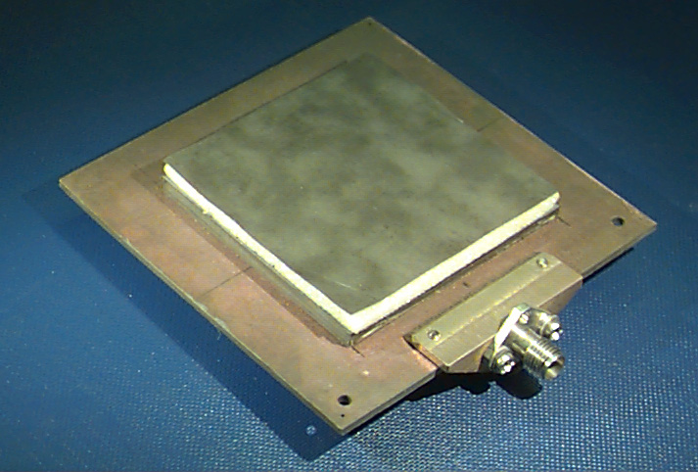
ECE 6345
Spring 2024
Prof. David R. Jackson
ECE Dept.
Notes 29

Slide 2
Overview
In this set of notes we derive the SDI formulation using a more mathematical, but general, approach (we directly Fourier transform Maxwell’s equations).
This allows for all possible types of sources to be treated in one derivation.

Slide 3
General SDI Method
Start with Ampere’s law:
where
Assume a 2D spatial transform:

Slide 4
General SDI Method (cont.)
Hence, we have:
Next, represent the field as
Note that
Then take the components of the transformed Ampere’s equation.

Slide 5
General SDI Method (cont.)
Examine TM_{z} field:
Ignore the equation.
(1)
(2)

Slide 6
TM_{z} Fields
We wish to eliminate . To do this, use Faraday’s law:
Take the component of the transformed Faraday’s Law:
(3)

Slide 7
TM_{z} Fields (cont.)
Substitute from (1) into (3) to obtain
Putting all the sources on the RHS:
Note that

Slide 8
TM_{z} Fields (cont.)
Hence, we have:
(4)

Slide 9
TM_{z} Fields (cont.)
Equations (2) and (4) are rewritten as

Slide 10
TM_{z} Fields (cont.)
Define:
We then have:

Slide 11
Telegrapher’s Equations
i⁻
i⁺
+
+
v⁻
v⁺
-
-
Δz
Allow for distributed sources
so

Slide 12
Telegrapher’s Equations (cont.)
Hence, in the phasor domain,
Also,
so
Hence, in the phasor domain,

Slide 13
Telegrapher’s Equations (cont.)
Compare field equations for TM_{z} fields with TL equations:

Slide 14
Telegrapher’s Equations (cont.)
We then make the following identifications:
Hence
or

Slide 15
Sources: TM_{z}
For the sources we have, for the TM_{z} case:

Slide 16
Sources: TM_{z} (cont.)
Special case: planar surface-current sources
Assume
Then we have
This is a lumped parallel current generator.
Similarly, we have:
This is a lumped series voltage generator.

Slide 17
Sources: TM_{z} (cont.)
Special case: vertical planar electric current
If
Then we have
z = 0
Example:
(unit-amplitude vertical electric dipole)

Slide 18
TE_{z} Fields
Use duality:
TM_{z}
TE_{z}

Slide 19
TE_{z} (cont.)
Define
We then identify:

Slide 20
TE_{z} (cont.)
For the sources, we have:
Special case of vertical planar currents:
Special case of horizontal surface currents:

Slide 21
Summary
Special case of horizontal surface currents:

Slide 22
Summary (cont.)
Special case of vertical planar currents:

Slide 23
Example
Calculate
This is the E_{z} field at (x, y, z) due to a unit-amplitude vertical dipole at (x′, y′, z′).
To calculate use:
We then have
so that

Slide 24
Example (cont.)
We have:
The TE part cancels when we substitute these expressions into the expression for the transform of E_{z}, so we have:

Slide 25
Example (cont.)
We then have:
Ignore
(We assume that we are not inside the source dipole.)
From the strength of the TM voltage generator due to a unit-amplitude vertical dipole at z′, we then have:
Hence, we have:

Slide 26
Example (cont.)
In the space domain we have (after taking the 2D inverse Fourier transform):

Slide 27
Example (cont.)
Converting to polar coordinates, we have (for any function F):

Slide 28
Example (cont.)
In the space domain we then have:
so that
Note: The integral does not converge when z = z′.

