Slide 1
ECE 6345
Fall 2024
David R. Jackson
Notes 1
Cavity Model

Slide 2

Cavity Model for Patch Antenna
We use the cavity model and the method of eigenfunction expansion to solve for the input impedance of the rectangular microstrip patch antenna.
The cavity model is an efficient and yet accurate method for calculating the input impedance.
The cavity model justifies the RLC circuit model.
I₀ current feed at (x₀, y₀)

Slide 3
Cavity Model
Physical patch
Accounting for fringing:
PMC
PEC
Note: The coordinates (x₀, y₀) are measured from the corner of the physical patch.
(Hammerstad formula)
Note:
ΔL is often chosen from Hammerstad’s formula.
ΔW is often chosen from Wheeler’s formula.
(Wheeler formula)

Slide 4
Cavity Model (cont.)
Accounting for loss and radiation:
PMC
PEC
Assume no z variation (the probe current is constant in the z direction.)

Slide 5
Cavity Model (cont.)
or
(This includes radiation loss)

Slide 6
Cavity Model (cont.)
CAD Formulas for Q Factors (derived later)

Slide 7
Cavity Model (cont.)
CAD Formulas for Q Factors (cont.)

Slide 8
Helmholtz Equation for E_{z}
We first derive the Helmholtz equation for E_{z}.
(nonmagnetic substrate)
Substituting Faraday’s law for H into Ampere’s law, we have:

Slide 9
Helmholtz Equation for E_{z} (cont.)
Hence
Feed (impressed) current
Denote
We take it here to be a filamentary source (zero radius).
Then
PMC
PEC

Slide 10
Mathematical Problem
The function ψ is really a 2-D Green’s function, if the feed current is filamentary.

Slide 11
Eigenvalue Problem
Eigenvalue problem:
The original eigenvalue problem is thus reduced to this simpler “reduced” eigenvalue problem.
New notation:

Slide 12
Eigenvalue Problem (cont.)
Introduce eigenfunctions of the 2-D Laplace operator:
For a rectangular patch we have, from separation of variables (or guessing):
Note:
The eigenvalues are real and the eigenfunctions are orthogonal.

Slide 13
Eigenfunction Expansion
Assume an “eigenfunction expansion”:
This must satisfy
Hence
Using this property of the eigenfunctions, we have:

Slide 14
Eigenfunction Expansion (cont.)
Multiply the previous equation by and integrate.
Note that the eigenfunctions are orthogonal, so that
Note: The eigenfunctions are real, so we can drop the conjugate here if we want.
Define
We then have:

Slide 15
Eigenfunction Expansion (cont.)
Hence, we have (removing the primes in the notation):
Recall:
Therefore:
The field inside the patch cavity is then given by

Slide 16
Eigenfunction Expansion (cont.)
For the rectangular patch:
where
We need:

Slide 17
Eigenfunction Expansion (cont.)
The result is:

Slide 18
Eigenfunction Expansion (cont.)
For a filamentary feed current we have:
Hence, we have

Slide 19
Eigenfunction Expansion (cont.)
The final form for the field inside the patch cavity is then given by:

Slide 20
Final Field Inside Cavity
Substituting in for all of the terms, we have:
Note:
It is usually the (1,0) mode that is resonant.
Note: It is not obvious, but the field goes to infinity when

Slide 21
Green’s Function
Using a Green's function notation, we have (setting I₀ = 1):
For an arbitrary impressed current excitation inside the cavity, we then have:

Slide 22
Input Impedance
To calculate the input impedance, we need to consider a nonzero radius of the feed probe.
Feed probe
Note: Because the probe is made of PEC, there is a surface current on it.

Slide 23
Input Impedance (cont.)
We first calculate the electric field E_{z} inside the patch cavity due to the probe.
It is convenient to use a strip model of the probe.

Slide 24
Input Impedance (cont.)
For a “Maxwell” strip current assumption, we have:
Note: The total probe current is I₀ amps.

Slide 25
Input Impedance (cont.)
For a uniform strip current assumption, we have:
Note: The total probe current is I₀ amps.
(We will use this model.)

Slide 26
Input Impedance (cont.)
Field inside cavity due to probe:
(arbitrary impressed volumetric current in cavity)
(arbitrary impressed surface current on a contour)
(strip current)
(uniform strip current model)
Term that needs to be integrated

Slide 27
Input Impedance (cont.)
Integration over the strip current:
Integrates to zero (odd)

Slide 28
Input Impedance (cont.)
The field inside the cavity due to the strip probe current is then:
We next use the field inside the cavity to find the input impedance. We first calculate the complex power going into the patch, which is the complex power radiated by the probe current inside the cavity.

Slide 29
Input Impedance (cont.)
We need this integral:

Slide 30
Input Impedance (cont.)
The final result is:
Note:
We cannot assume a probe of zero radius, or else the series will not converge – the input reactance will be infinite.

Slide 31
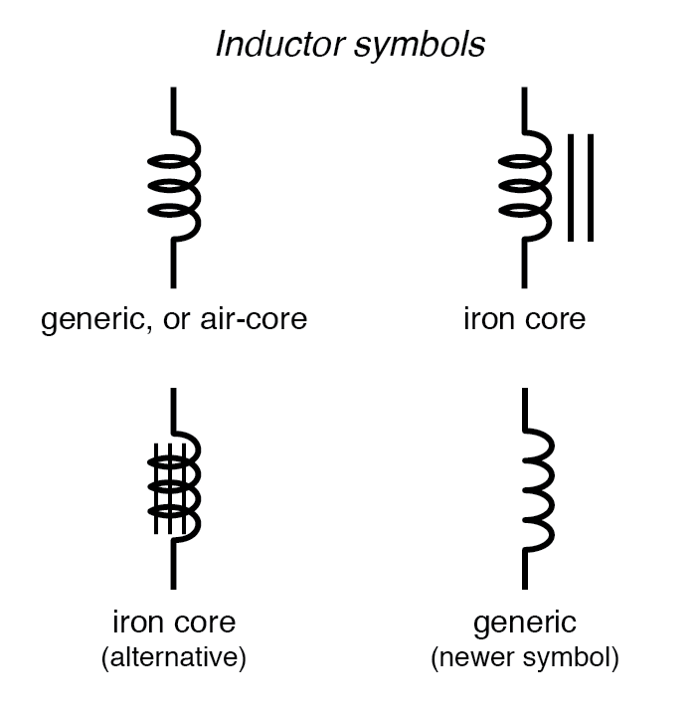
Circuit Model
Probe (feed) inductance
(accounts for all modes (m,n) ≠ (1,0))
Probe
Patch cavity
(1,0 mode resonator)
Resonance frequency:
This formula, which describes the above circuit model, comes from approximating the input impedance formula. (This is done in just a bit!)

Slide 32
Results
Z_{in} (Ω)
Z_{in} (Ω)
Freq. (GHz)
Freq. (GHz)
Patch
Feed
Z_{in} (Ω)
Freq. (GHz)

Slide 33
Probe Inductance
Note that
(1,0) = term that corresponds to the dominant patch mode current (impedance of RLC circuit).
Hence, we have:

Slide 34
Probe Inductance (cont.)
Results: Probe Reactance (X_{f} =X_{p}= ωL_{p})
Rectangular patch
CAD:
(x₀, y₀)
L
Exact:
The cavity model for X_{p} with all infinite modes
(excluding the (1,0) term).
Center
Edge
The normalized feed location ratio x_{r} is zero at the center of the patch (x = L/2), and is 1.0 at the patch edge (x = L).

Slide 35
RLC Model
We can write
where
(The P_{mn} coefficients are not a function of frequency.)

Slide 36
RLC Model (cont.)
We can then write
Note:
k₁ is the wavenumber of a lossless substrate having the (real) relative permittivity ε_{r}.

Slide 37
RLC Model (cont.)
We can write this as:
  Also, define:
Next, use:

Slide 38
RLC Model (cont.)
Then
or

Slide 39
RLC Model (cont.)
Near the resonance of the TM₁₀ mode, for , we have:
(RLC equation)
This justifies the RLC model near resonance of the TM₁₀ mode.

Slide 40
(0,0) Mode
Note that for the (0,0) mode
or
Also, we have:

Slide 41
(0,0) Mode (cont.)
Hence
or
As expected, the (0,0) mode acts as a parallel-plate capacitor.

Slide 42
Nonresonant Modes
For any other nonresonant mode (m,n) ≠ (1,0) or (0,0):
Note:
This is not true for the (0,1) mode, but this mode is not excited when feeding on the centerline.

Slide 43
RLC Circuit Model
Circuit model:
Note:
This circuit model is accurate as long as we are near the resonance of the (1,0) circuit.

Slide 44
RLC Circuit Model (cont.)
Lumping all of the nonresonant circuits together into a “probe reactance”, we have:
This gives us the CAD model for the patch.

