Slide 1
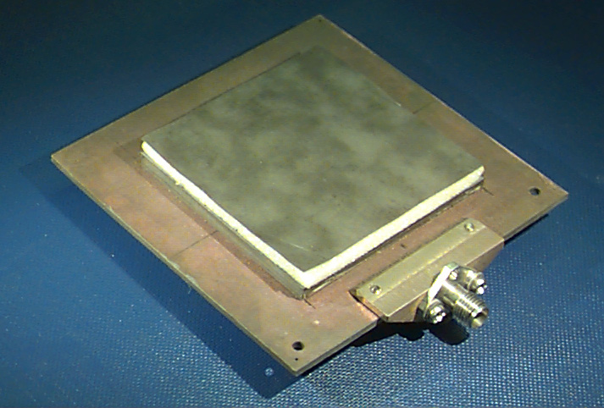
ECE 6345
Spring 2024
Prof. David R. Jackson
ECE Dept.
Notes 6

Slide 2
Overview
This set of notes treats circular polarization, obtained by using a single feed.
The nearly-square patch is fed with a coaxial feed along the diagonal.
y
W
(x₀, y₀)
x
L

Slide 3
Overview
Goals:
Find the optimum dimensions of the CP patch
Find the input impedance of the CP patch
Find the pattern (axial-ratio) bandwidth of the CP patch
Find the impedance bandwidth of the CP patch
We use the electric current model, and thus work with the currents on the patch.

Slide 4
Amplitude of Patch Currents
First Step:
Find the patch currents (x and y directions), and then relate them to the input impedance of the patch.
Assume:

Slide 5
Amplitude of Patch Currents (cont.)
Patch currents:
x-directed current mode (TM₁₀):
y-directed current mode (TM₀₁):

Slide 6
Amplitude of Patch Currents (cont.)
The x mode (TM₁₀):
so
Assume:
To find E, use

Slide 7
Amplitude of Patch Currents (cont.)
For the TM₁₀ mode we have, from the last slide:
And thus, solving for A_{x}:
A similar derivation holds for the y mode (TM₀₁).

Slide 8
Amplitude of Patch Currents (cont.)
The y mode (TM₀₁):
The patch current amplitudes can then be written as:
where

Slide 9
Amplitude of Patch Currents (cont.)
y
Assume:
Then
W
(x₀, y₀)
x
L

Slide 10
Amplitude of Patch Currents (cont.)
Because of the nearly equal dimensions and the feed along the diagonal, we also have:
(The resistor in the circuit model for either mode is the same.)
= resonant input resistance of the mode x, when excited by itself, and similarly for
We then have:
where
Notation: The bar denotes impedances that are normalized by R.

Slide 11
Amplitude of Patch Currents (cont.)
The A₂ coefficient can be written as:
Note:
We can use the CAD formula for R_{edge}.
so

Slide 12
Circular Polarization Condition
y
Let
W
(x₀, y₀)
x
The CP condition is
L
A_{x} = amplitude of x mode current (TM₁₀)
A_{y} = amplitude of y mode current (TM₀₁)
for RHCP
+ for LHCP

Slide 13
Circular Polarization Condition (cont.)
The frequency f_{CP} is defined as the frequency for which we get CP at broadside.
We have, from the CAD circuit model:
So, for each mode we have:
where
f_{x} = resonance frequency of TM₁₀ mode
f_{y} = resonance frequency of TM₀₁ mode

Slide 14
Circular Polarization Condition (cont.)
LHCP:
Choose:
Then we have:
(LHCP)

Slide 15
Circular Polarization Condition (cont.)
The frequency conditions for f = f_{CP} can be written as:
so
or

Slide 16
Circular Polarization Condition (cont.)
Also,
Let
Note:
For RHCP, the two frequencies are reversed.
Then we have:

Slide 17
Circular Polarization Condition (cont.)
Summary of frequencies
(LHCP)
(RHCP)
f_{CP} = frequency for which we get CP at broadside.

Slide 18
Patch Dimensions for CP
PMC
PMC
(Hammerstad formula)

Slide 19
Patch Dimensions for CP (cont.)
Top sign: LHCP
Bottom sign: RHCP
Define:
(These are known wavenumbers, since the frequencies are known.)
(resonance condition)
Now we know the effective dimensions of the patch.

Slide 20
Patch Dimensions for CP (cont.)
For the physical patch dimensions we have:
Note: For ΔW, we use the same formula as ΔL , but replace W → L.

Slide 21
Physical Dimensions for CP (cont.)
Summary of Design Equations
where
Patch Dimensions
Top sign: LHCP, Bottom sign: RHCP
Note: The fringing length ΔL depends on W, and the fringing length ΔW depends on L.

Slide 22
Physical Dimensions for CP (cont.)
Iterative Design Process:
Neglect fringing extensions, and take L = L_{e} and W = W_{e}.
Solve for the fringing extensions ΔL and ΔW using the Hammerstad formula.
Solve for L = L_{e} - 2ΔL and W = W_{e} - 2ΔW .
Repeat from step 2 if necessary.

Slide 23
Input Impedance of CP Patch
At f_{CP}:
(LHCP)
so
or
The CP frequency f_{CP} is also the resonance frequency where the input impedance is real
(if we neglect the probe inductance).
Recall: R = R^{x} = R for TM₁₀ mode

Slide 24
Input Impedance of CP Patch (cont.)
Hence, at the resonance (CP) frequency f_{CP} we have
R_{edge} = R_{edge} for TM₁₀ mode
Note: We have a CAD formula for R_{edge}.
The feed position x₀ can be chosen to give the desired input resistance at the resonance frequency f_{CP}.

Slide 25
Input Impedance of CP Patch (cont.)
A physical picture of the frequencies (LHCP):

Slide 26
CP (Axial Ratio) Bandwidth
We now examine the frequency dependence of the term A_{y} / A_{x} .
where
This is the ratio of the operating frequency to the CP frequency.
(LHCP)

Slide 27
CP Bandwidth (cont.)
Then
Similarly,

Slide 28
CP Bandwidth (cont.)
Hence, we have:
Note:
Let
Then

Slide 29
CP Bandwidth (cont.)
y
(LHCP)
x

Slide 30
CP Bandwidth (cont.)
From ECE 6340:
where
with
In our case:

Slide 31
CP Bandwidth (cont.)
Set
From a numerical solution:

Slide 32
CP Bandwidth (cont.)
Hence, we have:
so
Therefore,
Hence, we have:

Slide 33
Impedance Bandwidth
(LHCP)
where
Note: At x = 0 we have

Slide 34
Impedance Bandwidth (cont.)
Set
(bandwidth limits)
(derivation omitted)

Slide 35
Impedance Bandwidth (cont.)
Hence
so
The band edges (in normalized frequency) are then

Slide 36
Impedance Bandwidth (cont.)
Hence
Hence

Slide 37
Summary
CP antenna
Linear antenna

