Slide 1
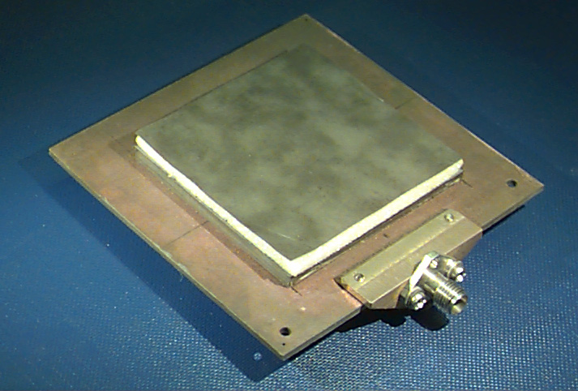
ECE 6345
Spring 2024
Prof. David R. Jackson
ECE Dept.
Notes 8

Slide 2
Overview
In this set of notes we use reciprocity to calculate the far field of a rectangular patch using the electric-current model, assuming an infinite substrate.
Review of reciprocity to calculate the far field.
Far field of horizontal electric dipole in the x direction (hex) on top of a grounded the substrate.
Far field of dominant mode of rectangular patch, using the electric current model and infinite substrate.

Slide 3
Far-Field
Reciprocity theorem:
Consider an electric current source:

Slide 4
Far-Field (cont.)
Let

Slide 5
Far-Field (cont.)
Hence
Assume
ipw = “incident plane wave”
Hence, we have:
FF = “far field”

Slide 6
Far-Field (cont.)
Consider a dipole in free space:
The primed coordinates denote local coordinates.
At
we have:

Slide 7
Far-Field (cont.)
In general, we have this picture:
At O :
where
At (0, 0, 0):

Slide 8
Far-Field (cont.)
For an arbitrary observation point r = (x, y, z) we have:
where

Slide 9
Far-Field (cont.)
Hence
Similarly, if
then we have:
X
X

Slide 10
Far-Field (cont.)
Now consider an object near the radiating current:
Body
We then have:
If the “body” is an infinite layered dielectric structure, the scattered field can be calculated exactly.

Slide 11
Far-Field (cont.)
For a magnetic current source:
Body
We then have:
where

Slide 12
Electric Dipole
Far field of HED
Infinite substrate
“hex” = unit-amplitude horizontal electric dipole (HED) in the x direction.
rpw = “reflected plane wave”

Slide 13
Electric Dipole (cont.)
For
TM_{z}
Infinite substrate
For
TE_{z}
X
X
Infinite substrate

Slide 14
Transverse Equivalent Network (TEN)
+
-

Slide 15
TEN (cont.)
For a wave traveling in the z′ = - z direction, we use:
This is the situation for our incident wave.
-
+

Slide 16
TEN (cont.)
where
and
or

Slide 17
TEN (cont.)
From Snell’s law:
Hence, we have:
Define:
Then we have:

Slide 18
TEN (cont.)
Also, we have:
General Medium
Free-space

Slide 19
Electric Dipole Source

Slide 20
Electric Dipole Source: TEN
so

Slide 21
Electric Dipole Source: TEN (cont.)
The radiated field is then:
We then have:

Slide 22
Electric Dipole Source: TEN (cont.)
For the TM reflection coefficient we have:
where
so
For the air region, we have:

Slide 23
Electric Dipole Source: TEN (cont.)
Note that
After simplifying, we obtain the following results:
Similarly, for the TE case we have:

Slide 24
Electric Dipole Source: Final Results
Hence, we have the following final results:

Slide 25
Electric Dipole: Final Results (cont.)
Results for a y-directed electric dipole:
We don’t need this for modeling the radiation from the TM₁₀ mode, however.

Slide 26
Far Field of Patch Current

Slide 27
Far Field of Patch Current (cont.)
Hence, we have:
hex = horizontal electric dipole in the x direction
The origin is at the center of the patch
Assume:

Slide 28
Far Field of Patch Current (cont.)
For this patch current we have the following Fourier transform:
where

Slide 29
Far Field of Patch Current (cont.)
Hence, we have:

Slide 30
Summary
W
L
Assumption:

Slide 31
Summary
E-plane pattern (φ = 0º)
H-plane pattern (φ = 90º)
Red: infinite substrate and ground plane
Comments:
Blue: 1 meter diameter ground plane
The E plane is broader than the H plane.
The E-plane pattern “tucks in” and tends to zero at the horizon due to the presence of the infinite substrate (green dot). (As the substrate gets thinner, the tuck-in point approaches 90º.)

