Slide 1
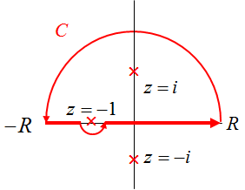
ECE 6382
Fall 2023
David R. Jackson
Notes 11
Evaluation of Definite Integrals via the Residue Theorem
Notes are from D. R. Wilton, Dept. of ECE

Slide 2
Review of Singular Integrals
1
Logarithmic singularities are examples of integrable singularities:
Note: There might be numerical trouble if one integrates this function numerically!

Slide 3
Review of Singular Integrals (cont.)
Singularities like 1/x are non-integrable.

Slide 4
Review of Cauchy Principal Value Integrals
Consider the following integral:
A finite result is obtained if the integral interpreted as
Excluded region
The infinite contributions from the two symmetrical shaded
parts shown exactly cancel in this limit. Integrals evaluated in this way are said to be (Cauchy) principal value (PV) integrals:
Notation:

Slide 5
Cauchy Principal Value Integrals (cont.)
1/x singularities are examples of singularities integrable only in the principal value (PV) sense.
Principal value integrals must not start or end at the singularity, but must pass through them to permit cancellation of infinities
Excluded region

Slide 6
Cauchy Principal Value Integrals (cont.)
Singularities like 1/x² are non- integrable (even in the PV sense).

Slide 7
Singular Integral Examples
Summary of some results:
Ln x is integrable at x = 0
1/x^{α} is integrable at x = 0 for 0 < α < 1
1/x^{α} is non-integrable at x = 0 for α ≥ 1
f (x) sgn(x)/|x|^{α} has a PV integral at x = 0 for α < 2 if f (x) is smooth (proof omitted)
(The above results translate to singularities at a point a via the transformation x → x - a.)

Slide 8
Integrals Along the Real Axis
Assumptions:
f is analytic in the UHP except for a finite number of poles.
f is , i.e. in the UHP.
UHP: Upper Half Plane
On the large semicircle we then have
Note:
If the function is analytic in the LHP except for poles, then we would close the contour in the LHP.
Hence

Slide 9
Integrals Along the Real Axis (cont.)
Example:

Slide 10
Cauchy Principal Value Integrals
Assumptions:
f is analytic in the UHP except for a finite number of poles.
f is , i.e. in the UHP.
A small semicircle of radius ρ is introduced at a simple pole on the real axis. We let ρ → 0.
Note:
If the function is analytic in the LHP except for poles, then we would close the contour in the LHP.
It is our choice to detour above or below the pole on the real axis.

Slide 11
Cauchy Principal Value Integrals
Example
Evaluate:
Consider the following integral:
Hence,
We could have also used the formula from Notes 10 for going halfway around a simple pole on a small semicircle (the residue at -1 is 1/2).

Slide 12
Cauchy Principal Value Integrals (cont.)
Next, evaluate the integral I_{C} using the residue theorem:
Thus:
Recall:
Hence:

Slide 13
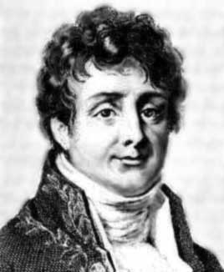
Fourier Integrals
Assumptions:
f is analytic in the UHP except for a finite number of poles (can easily be extended to handle poles on the real axis via PV integrals),
Choosing the contour shown, the contribution from the semicircular arc vanishes as R → ∞ by Jordan’s lemma.
(See next slide.)
Jean-Baptiste Joseph Fourier

Slide 14
Fourier Integrals (cont.)
Jordan’s lemma
Assume
Then
Proof:

Slide 15
Fourier Integrals (cont.)
We then have
Questions:
What would change if a < 0 ? If we had a negative sign in the exponential?

Slide 16
Fourier Integrals (cont.)
Example:
y
x
Use the symmetries of cos(λx) and sin(λx) and the Euler formula, we have:

Slide 17
Rational Functions of sin and cos
Assumptions:
f is finite within the interval.
f is a rational function (ratio of polynomials) of sinθ, cosθ.

Slide 18
Rational Functions of sin and cos (cont.)
Example:
Multiply top and bottom by 4i.
Note:
The poles (roots of the denominator) are found by using the quadratic equation.

Slide 19
Exponential Integrals
There is no general rule for choosing the contour of integration; if the integral can be done by contour integration and the residue theorem, the contour is usually specific to the problem.
Example:
Consider the contour integral over the path shown in the figure:
The contribution from each contour segment in the limit
must be separately evaluated (next slide).

Slide 20
Exponential Integrals (cont.)

Slide 21
Exponential Integrals (cont.)
Hence

Slide 22
Exponential Integrals (cont.)
We thus have
Therefore
Hence

Slide 23
Integration Around a Branch Cut
A given contour of integration is chosen: usually problem specific, usually must not cross a branch cut.
We take advantage of the fact that the integrand changes across the branch cut.
Usually an evaluation of the contribution from the branch point is required.
Example:
Assume the branch 0 ≤ θ < 2π
Note: We choose the branch cut on the positive real axis (the axis of integration).

Slide 24
Integration Around a Branch Cut (cont.)
First, note the integral exists since the integral of the asymptotic forms of the integrand at both limits exists:

Slide 25
Integration Around a Branch Cut
(principal branch)
We’ll evaluate the integral using the contour shown.
For either circle, use:

Slide 26
Integration Around a Branch Cut (cont.)
Now consider the various contributions to the contour integral:

Slide 27
Integration Around a Branch Cut (cont.)
For the path L₁:
For the path L₂:

Slide 28
Integration Around a Branch Cut (cont.)
Hence
Note: Arg (-1) = π here (0 < θ < 2π).
Therefore, we have
Hence

Slide 29
Hilbert Transforms
y
Assumptions:
UHP: Upper Half Plane
x
Consider:
CPV
(From the residue theorem or the Cauchy integral theorem.)

Slide 30
Hilbert Transforms (cont.)
Equate the real and imaginary parts:
Next, relabel:

Slide 31
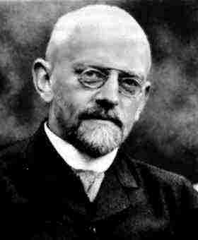
Hilbert Transforms (cont.)
Hence, we have
David Hilbert

Slide 32
Hilbert Transforms (cont.)
We can also repeat the derivation assuming that the function is analytic in the lower half plane.
Im
Re

Slide 33
Hilbert Transforms in Circuit Theory
(using j instead of i)
Transfer function
Poles are only allowed in the UHP.
LHP: Lower Half Plane
Note 1: A pole in the LHP would corresponds to a nonphysical growing response:
Note 2: The system is assumed to be unable to respond to a signal at very high frequency.
Symmetry property:
(see Appendix)

Slide 34
Hilbert Transforms in Circuit Theory (cont.)
We thus have:
Transfer function
The real and imaginary parts of the transfer function
are Hilbert transforms of each other.

Slide 35
Hilbert Transforms in Circuit Theory (cont.)
We can also derive an alternative form:
This integral starts at zero.
Similarly, we have

Slide 36
Dispersion Relation: Circuit Theory (cont.)
Summarizing, we have:

Slide 37
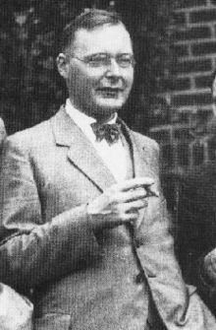
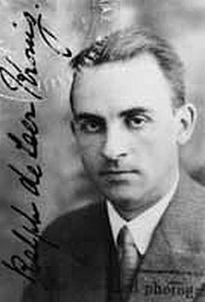
Kramers-Kronig Relations
Hendrik Anthony “Hans” Kramers
Ralph de Laer Kronig
The Kramers-Kronig relations are a fundamental set of equations that relate the real and imaginary parts of the complex permittivity.

Slide 38
Kramers-Kronig Relations
Assumption:
Similar to the transfer-function analysis, one obtains the Kramers-Kronig dispersion relations:

Slide 39
Kramers-Kronig Relations (cont.)
The final form of the Kramers-Kronig relations is then:
Note: This shows that if there is no loss (ε_{r}′′ = 0), then the relative permittivity must be 1. Hence, practical materials with ε_{r}′ > 1 will always have some loss.

Slide 40
Laplace Transform
The Laplace transform is defined as:
Assume
Analytic
Then F(s) is analytic in the region
Note: In the Laplace transform we do not care how f is defined for t < 0.

Slide 41
Laplace Transform (cont.)
Define a function g(t) (using any γ > γ₀):
The Fourier transform of g(t) exists.
(The function g (t) stays finite along the entire real axis and tends to zero as t → ± ∞.)
We then have, from the inverse Fourier transform,
Then, from the relation between f and g:
Let

Slide 42
Laplace Transform (cont.)
We have for the integrand term:

Slide 43
Laplace Transform (cont.)
Hence, we have:
“Inverse Laplace transform”
“Bromwich integral”
The Bromwich contour C is chosen to the right of all singularities of the function F(s).

Slide 44
Laplace Transform (cont.)
Consider the case:
Close the contour to the right.
(by Cauchy’s theorem)

Slide 45
Laplace Transform (cont.)
Summary
Note:
This inverse Laplace transform (Bromwich) integral gives us zero for t < 0, no matter how the original function f (t) was defined for t < 0.

Slide 46
Laplace Transform (cont.)
Evaluation of the Bromwich integral for the case of poles only:
Close the contour to the left.
Poles only
(This assumes that there are only pole singularities.)

Slide 47
Laplace Transform (cont.)
Example
For t > 0:

Slide 48
Appendix
Proof of symmetry property:
Transfer function
Impulse response:
so
Hence:

