Slide 1
ECE 6382
Fall 2023
David R. Jackson
Notes 14
The Gamma Function
Notes are from D. R. Wilton, Dept. of ECE

Slide 2
The Gamma Function
The Gamma function appears in many expressions, including Bessel functions, etc.
It generalizes the factorial function n! to non-integer values and even complex values.
It appears in the method of steepest descent (a method for obtaining the asymptotic expansion of a class of integrals).

Slide 3
Definition 1
Definition # 1
This definition gives the Gamma function a nice property for z = n (a positive integer), as proven on the next slide:
(factorial property)

Slide 4
Definition 1 (cont.)
Proof of factorial property:
Hence
or

Slide 5
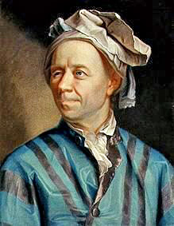
Definition 2
Definition # 2
This is the Euler-integral form of the definition.
Note:
Leonard Euler
Note:
Definition 1 is the analytic continuation of definition 2 from the right-half plane into the entire complex plane (except at zero and the negative integers).

Slide 6
Equivalent Integral Forms

Slide 7
Equivalence of Definitions 1 and 2
Equivalence of definitions #1 and #2
(Please see next slide.)

Slide 8
Equivalence of Definitions 1 and 2 (cont.)
Integration by parts development:
Integrate by parts once:

Slide 9
Equivalence of Definitions 1 and 2 (cont.)
Integrate by parts twice:
After n times:

Slide 10
Definition 3
Definition # 3
The Weierstrass product form can be shown to be equivalent to definitions #1 and #2.

Slide 11
Euler Reflection Formula
Euler Reflection Formula
(Proof omitted.)
Geometric interpretation of reflection formula:
In the horizontal direction, the two points are reflections about the x = 1/2 line.
Note: We can use this formula along with definition #2 to find Γ(z) for Re(z) < 0.

Slide 12
Euler Reflection Formula (cont.)
A special result that occurs frequently is Γ(1/2).
To calculate this, use the reflection formula:
Set z = 1/2:

Slide 13
Summary of Factorial Properties
Summary of Factorial Generalization
Integers
Real numbers
Complex numbers

Slide 14
Summary of Factorial Properties (cont.)
Summary of Factorial Generalization (cont.)
+
Complex numbers

Slide 15
Pole Behavior
Simple poles of Γ(z) are at n = 0, -1, -2, -3,…
Recall:
Use
Γ(z) has simple pole at z = 0
Residue = 1
Γ(z) has simple pole at z = -1
Residue = -1

Slide 16
Pole Behavior (cont.)
Γ(z) has simple pole at z = -2
Residue = +1/2
Γ(z) has simple pole at z = -3
Residue = -1/6

Slide 17
Pole Behavior (cont.)
Residues at Poles
In general (after n+1 steps), we will have:
Γ(z) has simple pole at z = -n
Hence

Slide 18
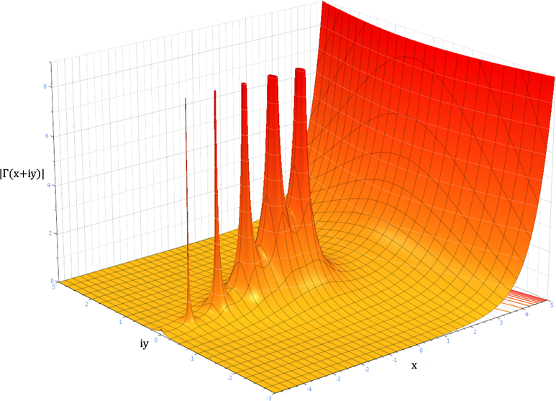
Plot of Gamma Function
Note: There are simple poles at z = 0, -1, -2,…

Slide 19
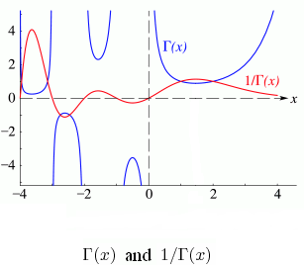
Plot of Gamma Function (cont.)
Γ(x) and 1 / Γ(x)
Note: Γ(x) never goes to zero.
In fact, 1 / Γ(z) is analytic everywhere.

Slide 20
Asymptotic Form of Gamma Function
Sterling’s formula (asymptotic series for large argument):
Taking the ln of both sides, we also have

