Slide 1
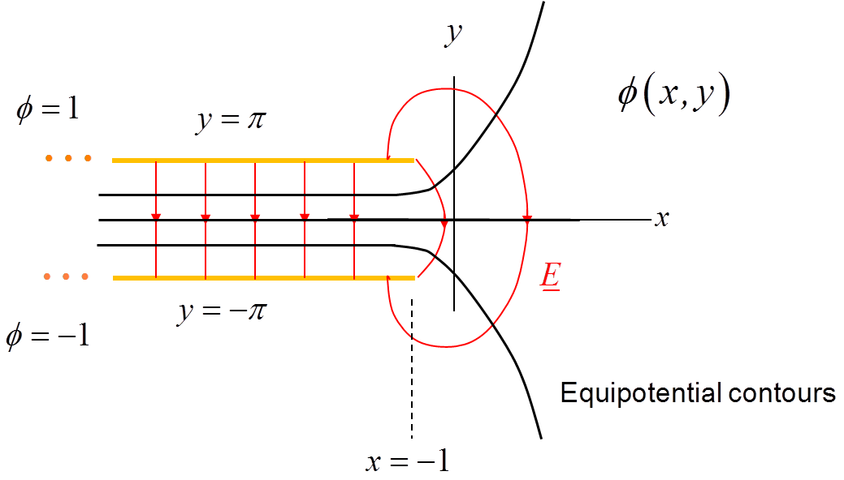
ECE 6382
Fall 2023
David R. Jackson
Notes 5
Conformal Mapping
Notes are adapted from D. R. Wilton, Dept. of ECE

Slide 2
Conformal Mapping
This is a method for solving 2D problems involving Laplace’s equation.
or
J. W. Brown and R. V. Churchill, Complex Variables and Applications, 9th Ed., McGraw-Hill, 2013.

Slide 3
Conformal Mapping (cont.)
The function f (z) is assumed to be analytic in the region of interest.
A complicated boundary in the z plane is mapped into a simple one in the w plane -- for which we know how to solve the Laplace equation.
z plane
w plane
Final Result:
Desired
Known
(We simply take ψ and map it back to the z plane.)

Slide 4
Conformal Mapping (cont.)
The key to being successful with the method of conformal mapping is to find a mapping that works for your problem
(i.e., it maps your problem into one the is simple enough for you to solve).
J. W. Brown and R. V. Churchill, Complex Variables and Applications, 9th Ed., McGraw-Hill, 2013.
An appendix has many basic conformal mappings.
H. Kober, Dictionary of Conformal Representations, Admiralty, Mathematical and Statistical Section, Dept. of Physical Research, 1945.
A very thorough compilation of conformal mappings.

Slide 5
Conformal Mapping (cont.)
Theorem:
If ψ (u,v) satisfies the Laplace equation in the (u,v) plane, then φ (x,y) satisfies the Laplace equation in the (x,y) plane.
Proof:
Assume that
or
We want to prove that

Slide 6
Conformal Mapping (cont.)
(partial derivative chain rule)
Using the product rule and the partial derivative chain rule:

Slide 7
Conformal Mapping (cont.)
Using the chain rule:

Slide 8
Conformal Mapping (cont.)
(The new color coding here shows how to combine terms.)
Use Cauchy-Riemann equations (red, blue, and black terms):
ψ satisfies Laplace’s equation.

Slide 9
Conformal Mapping (cont.)
Recall that for any analytic function f
Hence, we have
(proof complete)

Slide 10
Conformal Mapping (cont.)
Example
(This ψ satisfies Laplace’s equation.)
Given:
(This is an analytic mapping function.)
Verify φ (x,y) satisfies Laplace's equation.
Hence:
The function φ satisfies Laplace’s equation.

Slide 11
Conformal Mapping (cont.)
Example
(This satisfies Laplace’s equation.)
Given:
(This is an analytic mapping function.)
Verify φ (x,y) satisfies Laplace's equation.
Hence:
The function φ satisfies Laplace’s equation.

Slide 12
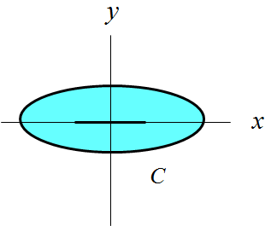
Conformal Mapping (cont.)
Theorem:
If ψ (u,v) satisfies Dirichlet or Neumann boundary conditions in the (u,v) plane, then φ (x,y) satisfies the same boundary conditions in the (x,y) plane.
Proof:
Assume that
Then we immediately have that
since

Slide 13
Conformal Mapping (cont.)
Next, assume that
Because of the angle-preserving (conformal) property of analytic functions, we have:

Slide 14
Conformal Mapping (cont.)
Relation Between Charge Densities in the Two Planes
so

Slide 15
Conformal Mapping (cont.)
From the last slide:
Hence, we have

Slide 16
Conformal Mapping (cont.)
Relation Between Capacitance in the Two Planes
The capacitance (per unit length) between two conductive objects remains unchanged between the z and w planes.
Proof:
(same voltage drop in both planes)

Slide 17
Conformal Mapping (cont.)
Consider this ratio:
Therefore,

Slide 18
Conformal Mapping (cont.)
Relation Between Electric Field in the Two Planes
dz = small displacement along flux line
dw = corresponding small displacement along flux line

Slide 19
Conformal Mapping (cont.)
Relation Between Electric Field in the Two Planes (cont.)
Note: The magnitude of the gradient gives us the rate of change of a function when we march in the direction of the gradient.
Hence
Note: The electric field vector in the z plane is also rotated from that in the w plane by - arg f ′ (z₀).

Slide 20
Summary of Important Properties
Laplace Eq. ⇔ Laplace Eq.
Dirichlet ⇔ Dirichlet
Neumann ⇔ Neumann

Slide 21
Example
Solve for the potential inside of a coax and
the capacitance per unit length of a coax.

Slide 22
Example (cont.)
PMC
PEC
PEC
PMC

Slide 23
Example (cont.)
(no v dependence in ψ)
Boundary conditions (solve for A and B)
PMC
PEC
PEC
PMC

Slide 24
Example (cont.)
so
or
(In the final answer we use ρ instead of r.)

Slide 25
Example (cont.)
so
PMC
PEC
PEC
PMC

Slide 26
Example
Solve for the potential inside and outside of a
semi-infinite parallel-plate capacitor.
Find the surface charge density on the lower surface of the top plate.

Slide 27
Example (cont.)

Slide 28
Example (cont.)
The corresponding colored dots show the mapping along the top plate.
Note: x reaches a maximum (x = -1) at u = 0.
Top plate
Note:
A negative value of u corresponds to being on the bottom surface of the top plate (see line styles).

Slide 29
Example (cont.)
This is an ideal infinite parallel-plate capacitor, whose solution is simple:
Note: The inside of the parallel-plate capacitor in the w plane gets mapped to the entire z plane.

Slide 30
Example (cont.)
The solution is:
where
For any given (x,y), these two equations have to be solved numerically to find (u,v).

Slide 31
Example (cont.)
+ + + + + ++ + + + + + + + + + + + + + + + + +
The charge density in the w plane on the lower surface of the top plate is:
The charge density in the z plane is:

Slide 32
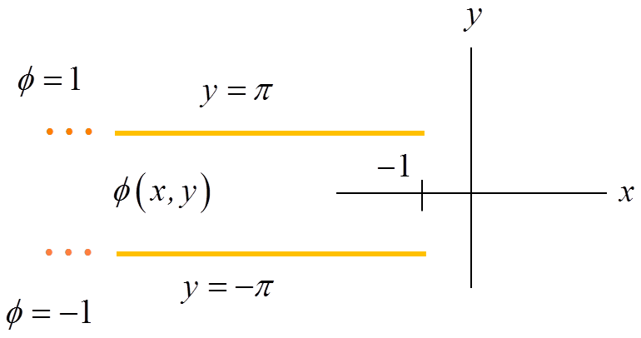
Example (cont.)
Hence, we have:

Slide 33
Example (cont.)
+ + + + + + ++
- - - - - - - - - -
Hence, we have on the bottom of the top plate:
where
(We must solve for u numerically, given a value of x.)
(on bottom of top plate)

Slide 34
Example (cont.)
Near Edge (u ≈0)
Rewriting in terms of x, we have:
Choose negative sign
(a negative value of u corresponds to the lower surface of the top plate).
See slide 28.

Slide 35
Example (cont.)
Hence, we have:
Near Edge
or

Slide 36
Example (cont.)
Near Edge
+
+
+
+
+
+
+
Near the upper edge (on the lower surface) we then have:
Note the square-root singularity at the edge!

Slide 37
Example (cont.)
Scaling the Answer
z plane
(This does not affect the Laplace equation.)
z′ plane

Slide 38
Example (cont.)
Shifting the Answer
where

Slide 39
Example
Solve for the potential surrounding a metal strip,
and the surface charge density on the strip.
Note: The potential goes to -∞ as ρ → ∞.

Slide 40
Example (cont.)
The outside of the circle gets mapped into the entire z plane.
The top of the strip corresponds to 0 < Θ < π.
Note: The inside of the cylinder also gets mapped to the entire z plane. However, inside the cylinder we have ψ ≡ 1, so this gives us a trivial solution with no electric field and no charge on the strip.

Slide 41
Example (cont.)
Outside the circle, we have (from electrostatic theory):
Note:
To be more general, we could use
From electrostatics (with no φ variation):
Changing the constant A₁ changes the total charge on the strip.
Changing the constant A₂ changes the voltage on the strip.
Gauss’s law
Gradient calculation

Slide 42
Example (cont.)
Hence, we have:
For any given (x,y), these two equations have to be solved numerically to find (R,Θ).

Slide 43
Example (cont.)
Charge density on strip
Note:
Going normal to the strip in the z plane means going normal to the circle in the w plane.
On the upper surface of the strip, we have:

Slide 44
Example (cont.)
Total charge on cylinder (per meter):
We then have

Slide 45
Example (cont.)
Next, use
so
so
or

Slide 46
Example (cont.)
On the circle:
so

Slide 47
Example (cont.)
On the strip:
so
Hence, we have
Note:
The surface charge density goes to infinity as we approach the edges.
This result was first derived by Maxwell!

Slide 48
Example (cont.)
Strip of width w
y
Here s is the distance from the edge.
Knife-edge singularity
++ + + + + + + + + ++
x
w
The strip now has a width of w.
Previous solution
(relabeled with x′)
New solution
Note: The total charge gets changed by a factor of w/4.

Slide 49
Example (cont.)
y
x
w
The total line charge density is now assumed to be ρ_{l} [C/m].
Note:
The normalization of 1/π corresponds to a unity total line charge density:

Slide 50
Example (cont.)
Microstrip line
Narrow strip:
y
w
h
x
Note:
The increased current density near the edges causes increased conductor loss and susceptibility to dielectric breakdown.
(This ignores the effects of the ground plane and the substrate – accurate for narrow strips.)

Slide 51
Example
Find the capacitance between two wires (tubes).
Note:
The left cylinder gets mapped into the outer coax cylinder.)
Radii and offset:
(from Churchill book)
For the coax we have:
J. W. Brown and R. V. Churchill, Complex Variables and Applications, 9th Ed., McGraw-Hill, 2013.

Slide 52
Example (cont.)
We therefore have (C_{z} = C_{w}):
where

Slide 53

Example (cont.)
Symmetrical “twin lead” Transmission Line
Scale this geometry by 1/a.
(This does not change the capacitance.)

Slide 54

Example (cont.)
Symmetrical “twin lead” Transmission Line
Scale by 1/a and shift
x

Slide 55
Example (cont.)
Symmetrical “twin lead” transmission line

Slide 56
Example (cont.)
Define:

Slide 57
Example (cont.)

Slide 58
Example (cont.)

Slide 59
Example (cont.)

Slide 60
Example (cont.)
Final Result

Slide 61
Example (cont.)
Final Result

Slide 62
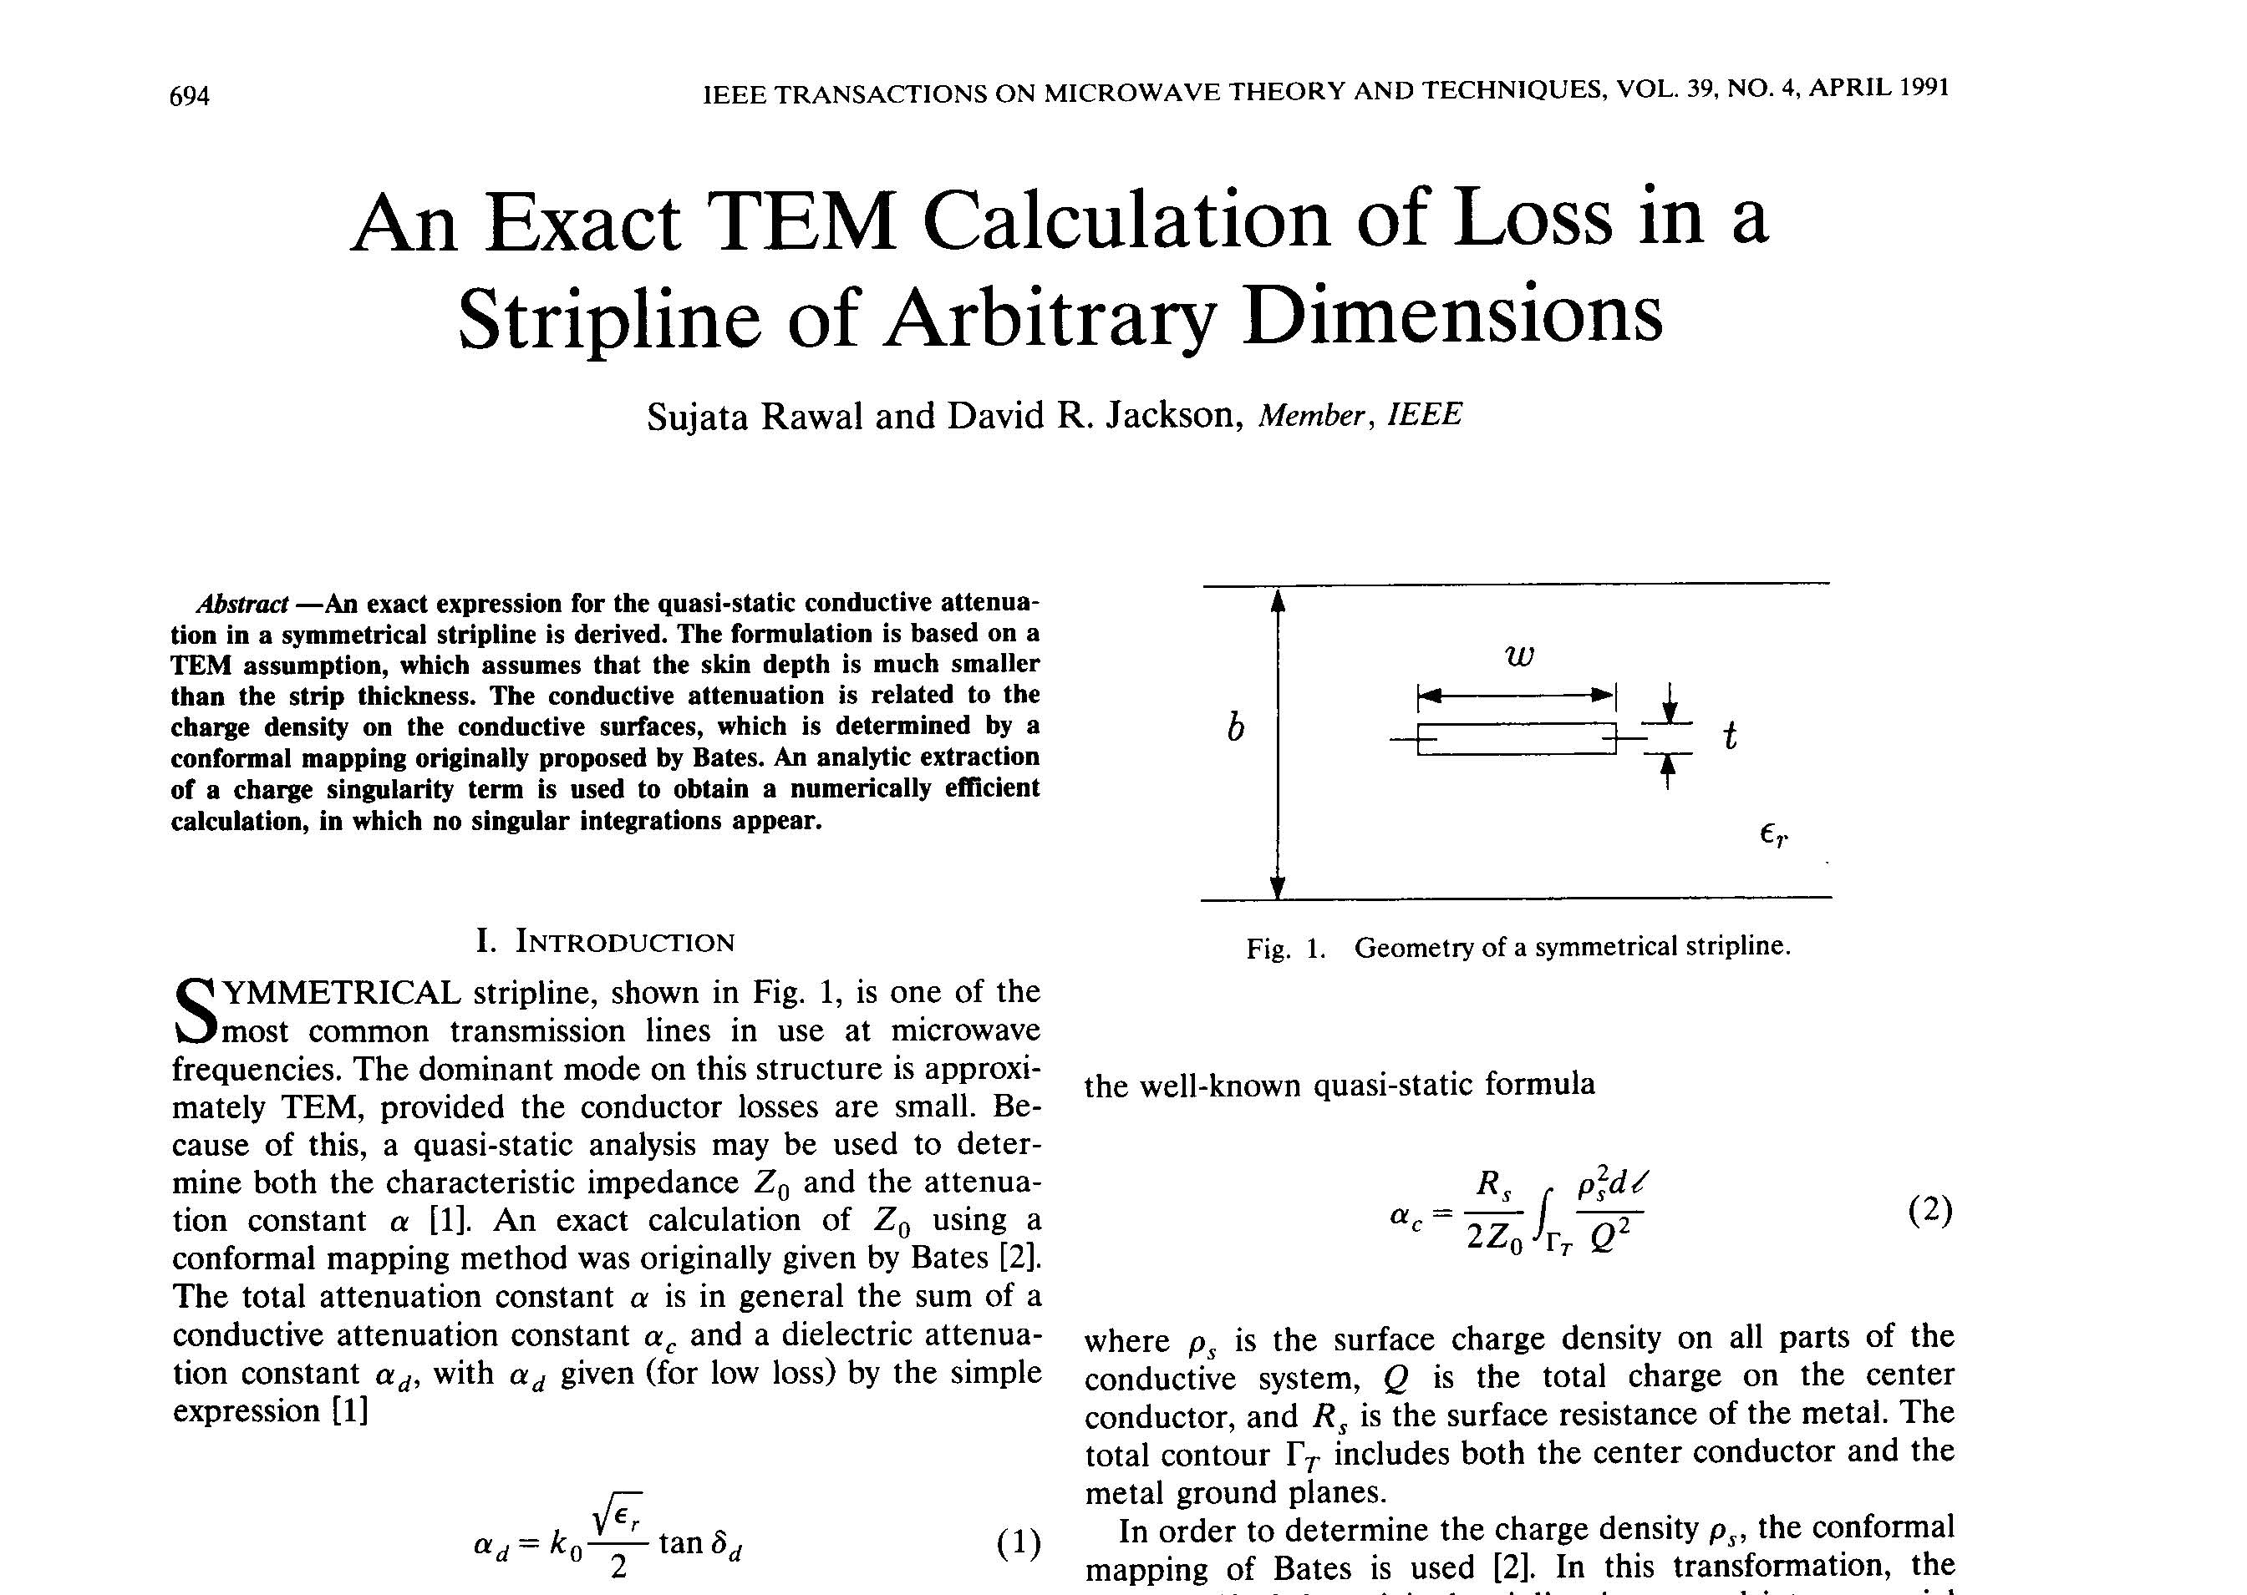
Example
Conductor attenuation on stripline

Slide 63
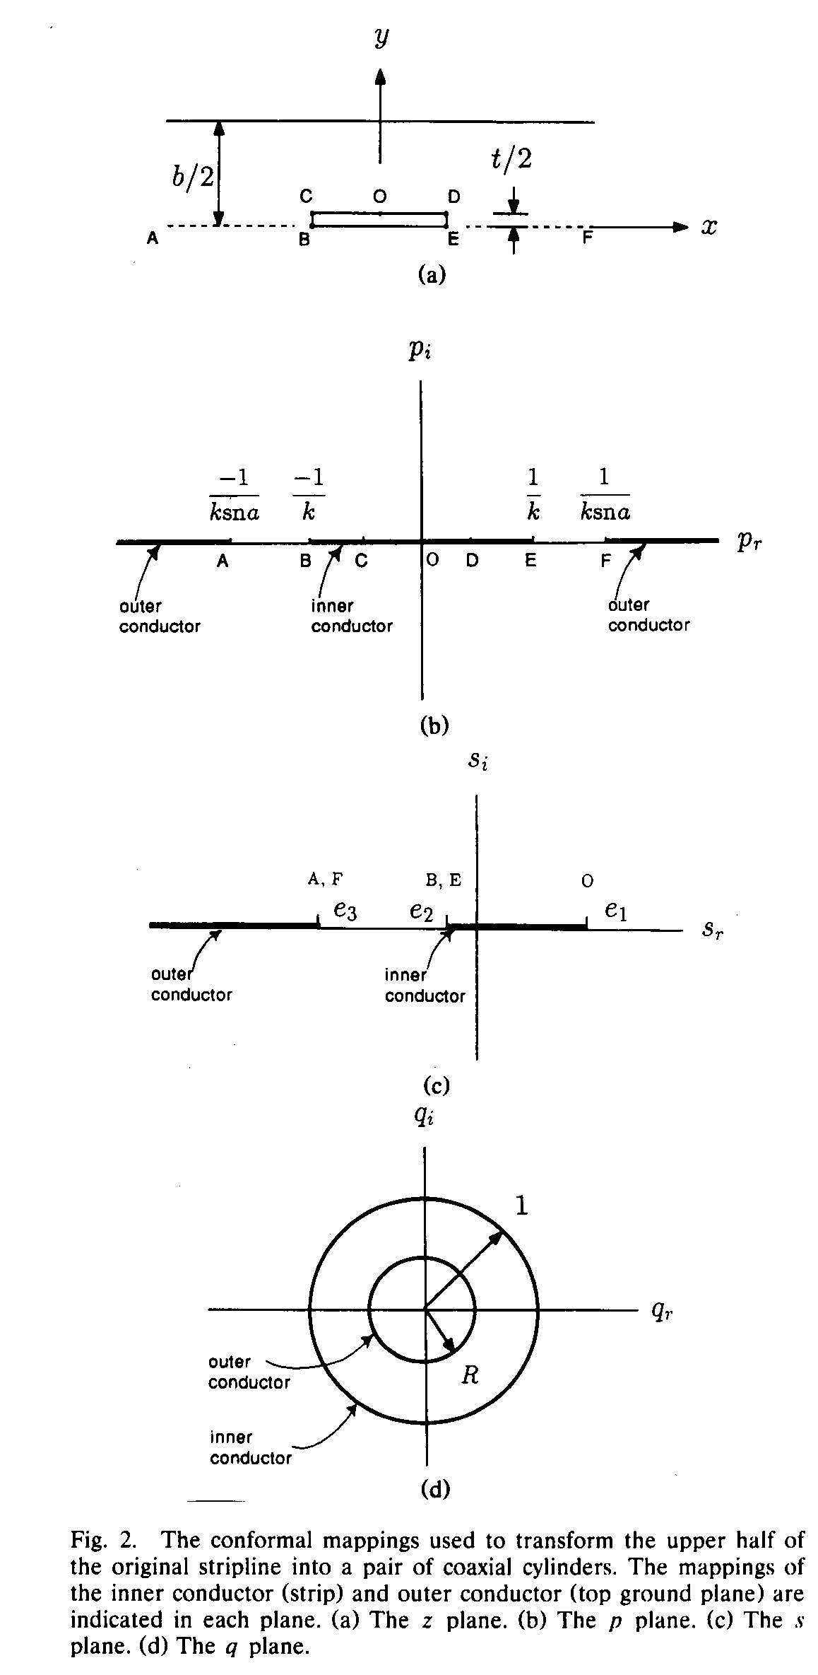
Example (cont.)
Conformal mapping of Bates:
sn = Jacobi elliptic function
P = Weierstrass elliptic function
R. H. T. Bates, “The characteristic impedance of the shielded slab line,” IRE Trans. Microwave Theory and Techniques, vol. MTT-4, pp. 28-33, Jan. 1956.

Slide 64
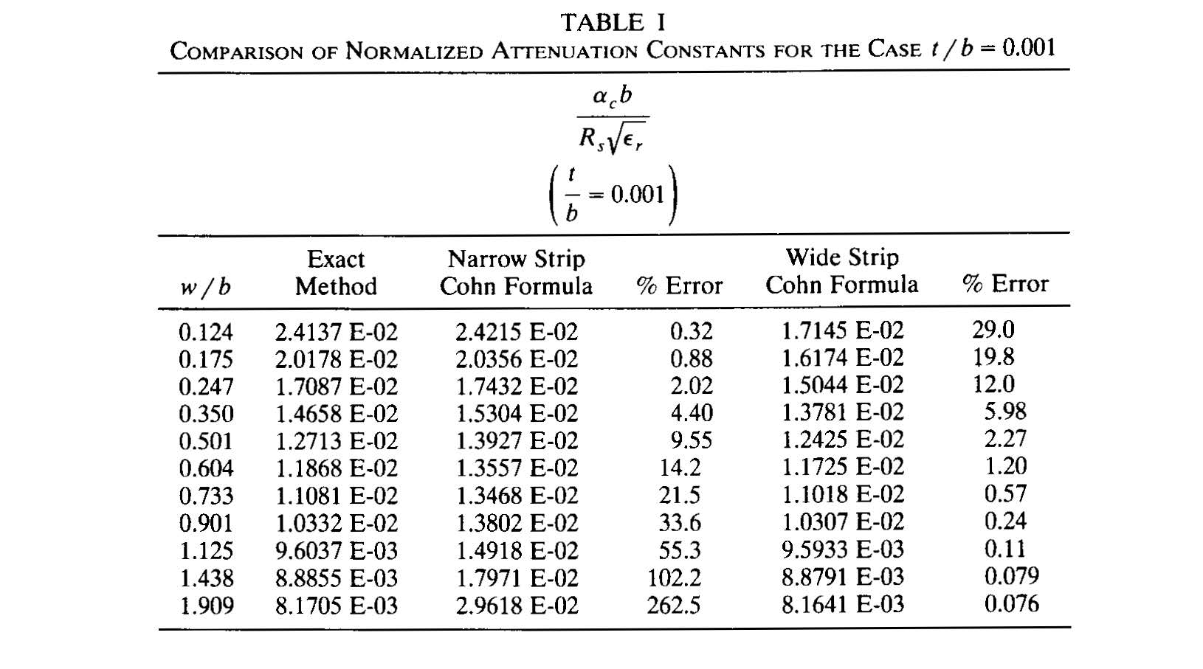
Example (cont.)

