Slide 1
ECE 6382
Fall 2023
David R. Jackson
Notes 6
Branch Points and Branch Cuts
Notes are adapted from D. R. Wilton, Dept. of ECE

Slide 2
Preliminary
Consider:
Choose:
There are two possible values.

Slide 3
Branch Cuts and Branch Points (cont.)
Consider what happens if we encircle the origin:
We don’t get back the same result!

Slide 4
Branch Cuts and Branch Points (cont.)
Now consider encircling the origin twice:
Recall: z ^{p/q} has q distinct values
(if p and q have no common factors).
We now get back the same result!
Hence the square-root function is a double-valued function.

Slide 5
Branch Cuts and Branch Points (cont.)
Next, consider encircling a point z₀ not at the origin.
Unlike encircling the origin, now we return to the same result!

Slide 6
Branch Cuts and Branch Points (cont.)
The origin is called a branch point: we are not allowed to encircle it if we wish to make the square-root function single-valued.
In order to make the square-root function single-valued and analytic in the domain, we insert a “barrier” or “branch cut”.
The function z^{1/2} is analytic off of the branch cut.
Here the branch cut is chosen to lie on the negative real axis (an arbitrary choice).

Slide 7
Branch Cuts and Branch Points (cont.)
We must now choose what “branch” of the function we want.
This is the “principal” branch
(the MATLAB choice*).
Note: MATLAB actually uses -π < θ ≤ π.
The square-root function is then defined on the negative real axis (though it won’t be analytic there):

Slide 8
Branch Cuts and Branch Points (cont.)
Here is the other branch choice.

Slide 9
Branch Cuts and Branch Points (cont.)
Note that the function is discontinuous across the branch cut.

Slide 10

Branch Cuts and Branch Points (cont.)
The function z^{1/2} is analytic off of the branch cut.

Slide 11
Branch Cuts and Branch Points (cont.)
The shape of the branch cut is arbitrary.

Slide 12
Branch Cuts and Branch Points (cont.)
The branch cut does not have to be a straight line.
In this case the branch is determined by requiring that the square-root function change continuously as we start from a specified value (e.g., z = 1).
(This means that the angle θ changes continuously.)
We start by assuming that θ = 0 at z = 1.
Note:
For the second branch, we would choose θ = 2π at z = 1.

Slide 13
Branch Cuts and Branch Points (cont.)
Branch points usually appear in pairs; here one is at z = 0 and the other at z = ∞ as determined by using ζ = 1/ z and then examining the function at ζ = 0.
We get a different result when we encircle the origin in the ζ plane (θ ′ changes by 2π) , which means encircling the “point at infinity” in the z plane.
Hence the branch cut for the square-root function connects the origin and the “point at infinity”.

Slide 14
Branch Cuts and Branch Points (cont.)
Consider this function:
What do the branch points and branch cuts look like for this function?

Slide 15
Branch Cuts and Branch Points (cont.)
There are now two branch points.
There are two branch cuts: we are not allowed to encircle either branch point.

Slide 16
Branch Cuts and Branch Points (cont.)
Geometric interpretation
To make the function unique, we agree on what the angles θ₁ and θ₂ are at one particular point.
Example: For z = 2, choose θ₁ = θ₂ = 0.

Slide 17
Branch Cuts and Branch Points (cont.)
We can rotate both branch cuts to the real axis.

Slide 18
Branch Cuts and Branch Points (cont.)
The two branch cuts “cancel”.
Both θ₁ and θ₂ have changed by 2π if we encircle both branch points.
Note that the function is the same at the two points shown.

Slide 19
Branch Cuts and Branch Points (cont.)
Note:
We are allowed to encircle both branch points, but not only one of them!
An alternative branch cut.

Slide 20
Branch Cuts and Branch Points (cont.)
Example:
4
3
2
1
5
6
7
Suppose we agree that at the point #1, θ₁ = θ₂ = 0. This should uniquely determine the value (branch) of the function everywhere in the complex plane.
Find the angles θ₁ and θ₂ at the other points labeled.

Slide 21
Branch Cuts and Branch Points (cont.)
Part (a): Proceed counterclockwise from point 1.
4
3
2
1
5
6
7
For example, at point 6:

Slide 22
Branch Cuts and Branch Points (cont.)
Part (b): Proceed clockwise from point 7.
(Assume that θ₁ = θ₂ = 0 at point 7)
4
3
2
1
5
6
7
For example, at point 6:

Slide 23
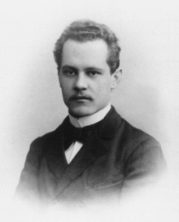
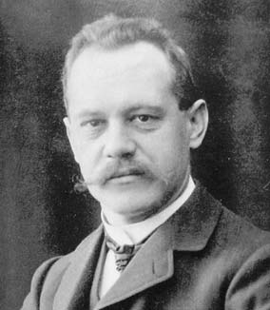
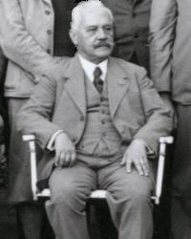
Sommerfeld Branch Cuts
Arnold Sommerfeld (1868-1951)
Sommerfeld branch cuts are the most common choice in dealing with radiation types of problems, where there is a square-root wavenumber function.

Slide 24
Sommerfeld Branch Cuts (cont.)
With this choice of branch cuts we have:
The first branch is defined by:
First branch:
Second branch:
Sommerfeld branch cuts
We can also say:
First branch:
Second branch:

Slide 25
Sommerfeld Branch Cuts (cont.)
Proof:
We first solve for the “boundary curve” where Re(f (z)) = 0.
First branch:
Second branch:
As long as we do not cross this hyperbolic contour, the real part of f does not change. Hence, the entire complex plane must have a real part that is either positive or negative (depending on which branch we are choosing) if the branch cuts are chosen to lie along this contour (i.e., the Sommerfeld branch cuts).

Slide 26
Sommerfeld Branch Cuts (cont.)
If the branch cuts are deformed to the boundary curve, the gray area disappears.
First branch
Boundary curve

Slide 27
Sommerfeld Branch Cuts (cont.)
Another point of view:
Let
Principal branch:
Mapping from w plane to z plane
z plane
w plane
Branch cuts map

Slide 28
Sommerfeld Branch Cuts (cont.)
Application: electromagnetic (and other) problems involving a wavenumber.
Note: j is used here instead of i.
or
(The – sign in front is an arbitrary choice here.)
The first branch is chosen in order to have decaying waves when k_{z} > k₀.
The entire complex plane (using the first branch) now corresponds to decaying waves (Im (k_{x}) < 0).

Slide 29
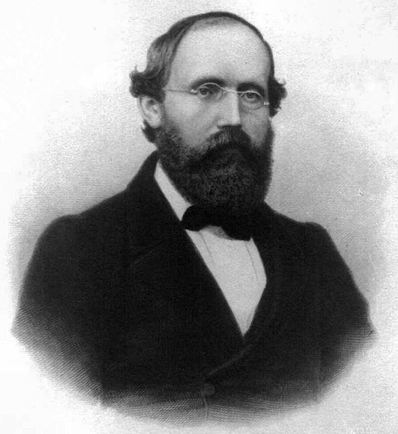
Riemann Surface
A Riemann surface is a surface that combines the different sheets of a multi-valued function.
It is useful since it displays all possible values of the function at one time.
(his signature)
Georg Friedrich Bernhard Riemann (1826-1866)

Slide 30
Riemann Surface (cont.)
The concept of the Riemann surface is first illustrated for
The Riemann surface is really two complex planes connected together.
The function z^{1/2} is analytic everywhere on this surface (there are no branch cuts), except at the origin. It also assumes all possible values on the surface.
Consider this choice:
Top sheet:
Bottom sheet:

Slide 31


Riemann Surface (cont.)
The angle θ changes smoothly on the surface!
Top
Bottom
The width of the escalator is collapsed to zero here.
Side view
Top view
“Escalator”
(where branch cut used to be)

Slide 32
Riemann Surface (cont.)
This figure shows going around a branch point twice.
Top sheet
Branch point
3D View
“Escalator”
(where branch cut used to be)
Bottom sheet
Note:
We are not allowed to jump from one escalator to the other!

Slide 33
Riemann Surface (cont.)
This figure shows going around a branch point twice.
Connection between sheets
(escalator)
Top View
r = 1
r
Note: 4π is the same as 0 for this function.

Slide 34
Riemann Surface (cont.)
The square root function is analytic on and inside this path, and the closed line integral around the path is thus zero.
C
The square root function is discontinuous on this path, and the closed line integral around the path is not zero.
C

Slide 35
Riemann Surface (cont.)
C
The 3D perspective makes it more clear that the integral around this closed path on the Riemann surface is zero. (The path can be shrunk continuously to zero.)

Slide 36
Riemann Surface (cont.)
Top sheet:
Defined by θ₁ = θ₂ = 0 on real axis for x > 1
There are two sets of up and down “escalators” that now connect the top and bottom sheets of the surface.

Slide 37
Riemann Surface (cont.)
Top sheet
Bottom sheet
The angle θ₁ has changed by 2π as we go back to the point z = 2.

Slide 38


Riemann Surface (cont.)
C₁ , C₂ are closed curves on the Riemann surface.
The integral around them is not zero!
(The paths cannot be shrunk to zero.)
Escalators
C₁ , C₂ are closed curves.
C₁
C₂
Escalators

Slide 39
Riemann Surface (cont.)
Sommerfeld (hyperbolic) shape of escalators

Slide 40
Riemann Surface (cont.)
Application to leaky modes:
Leaky modes (radiating modes) are improper
(exponentially increasing away from the structure).
Note: j is used here instead of i.
(forward wave)
In the air region:
x
(assume k_{y} = 0)
z
Leaky mode radiating in air
Imaginary part:
Assume:
Conclusion:
(improper!)

Slide 41
Riemann Surface (cont.)
Choose Sommerfeld (hyperbolic) shape of escalators.
Top sheet: surface-wave wavenumber
Bottom sheet: leaky-wave wavenumber
SW
LW
Leaky waves have a field that increases vertically (α_{x} < 0).

Slide 42
Other Multiple-Branch Functions
3 sheets
5 sheets
q sheets
Infinite number of sheets
Infinite number of sheets
The power π is an irrational number.

Slide 43
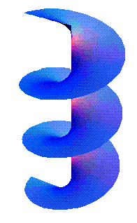
Other Multiple-Branch Functions (cont.)
Riemann surface for ln (z)
Note: There are no escalator pairs here: as we keep going in one direction (clockwise or counterclockwise), we never return to the original sheet.
Infinite # of sheets

