Slide 1
ECE 7366
Advanced Process Integration
Introduction
Dr. Wanda Wosik
UH, ECE
Text Book: B. El-Karek, “Silicon Devices and Process Integration”
Slides also include files from VLSI Era by Plummer et al., INTEL, etc.
Spring 2016
MW, 4-5:30pm

Slide 2
Our Course
Process Integration
The objective is to use sequential processes for meet particular requirements for various circuits
ITRS will be our main guiding tool

Slide 3
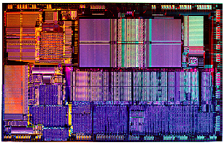
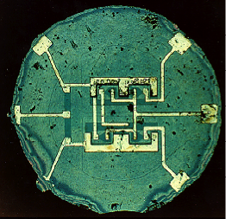
Evolution of the Silicon Integrated Circuits since 1960s
Increasing: circuit complexity, packing density, chip size, speed, and reliability
Decreasing: feature size, price per bit, power (delay) product
1960s
1990s
• 1960 and 1990 integrated circuits.
• Progress due to: Feature size reduction - 0.7X/3 years (Moore’s Law).
Increasing chip size - ≈ 16% per year.
“Creativity” in implementing functions.

Slide 4
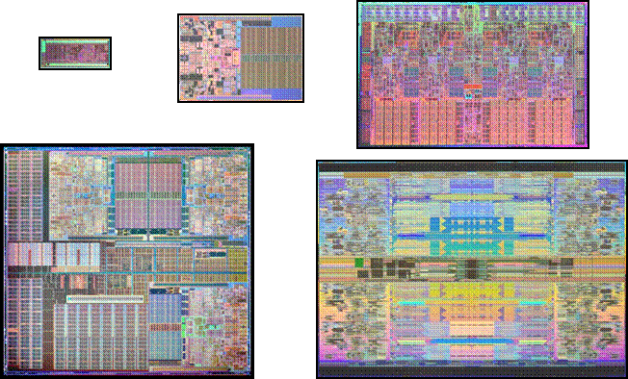
45 nm Microprocessor Products
Dual Core
Quad Core
Single Core
6 Core
8 Core
>200 million 45 nm CPUs shipped to date

Slide 5
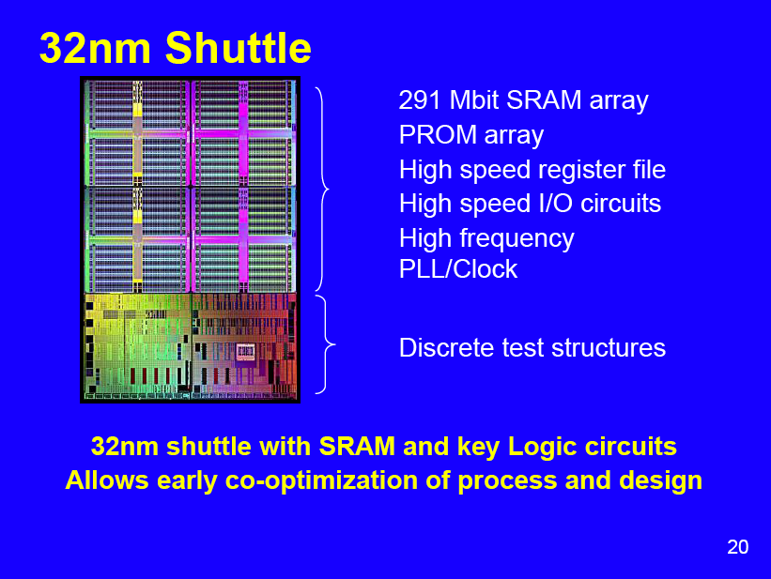
Intel

Slide 6
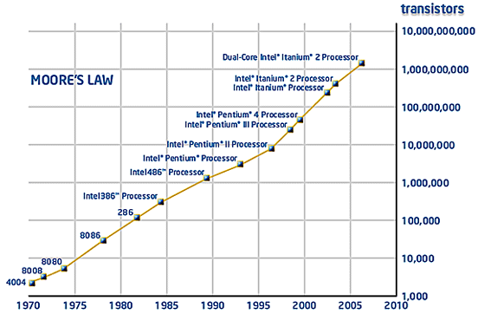
40+ Years of Moore’s Law at INTEL:
From Few to Billions of Transistors
2X transistors
every 2 years
Transistor Count has Doubled Every Two Years

Slide 7
40+ Years of Moore’s Law at INTEL:
From Few to Billions of Transistors
2X transistors
every 2 years
Traditional Scaling Era
END OF TRADITIONAL SCALING ERA ~ 2003
Lasted ~40 YEARS
Ghani, Intel

Slide 8
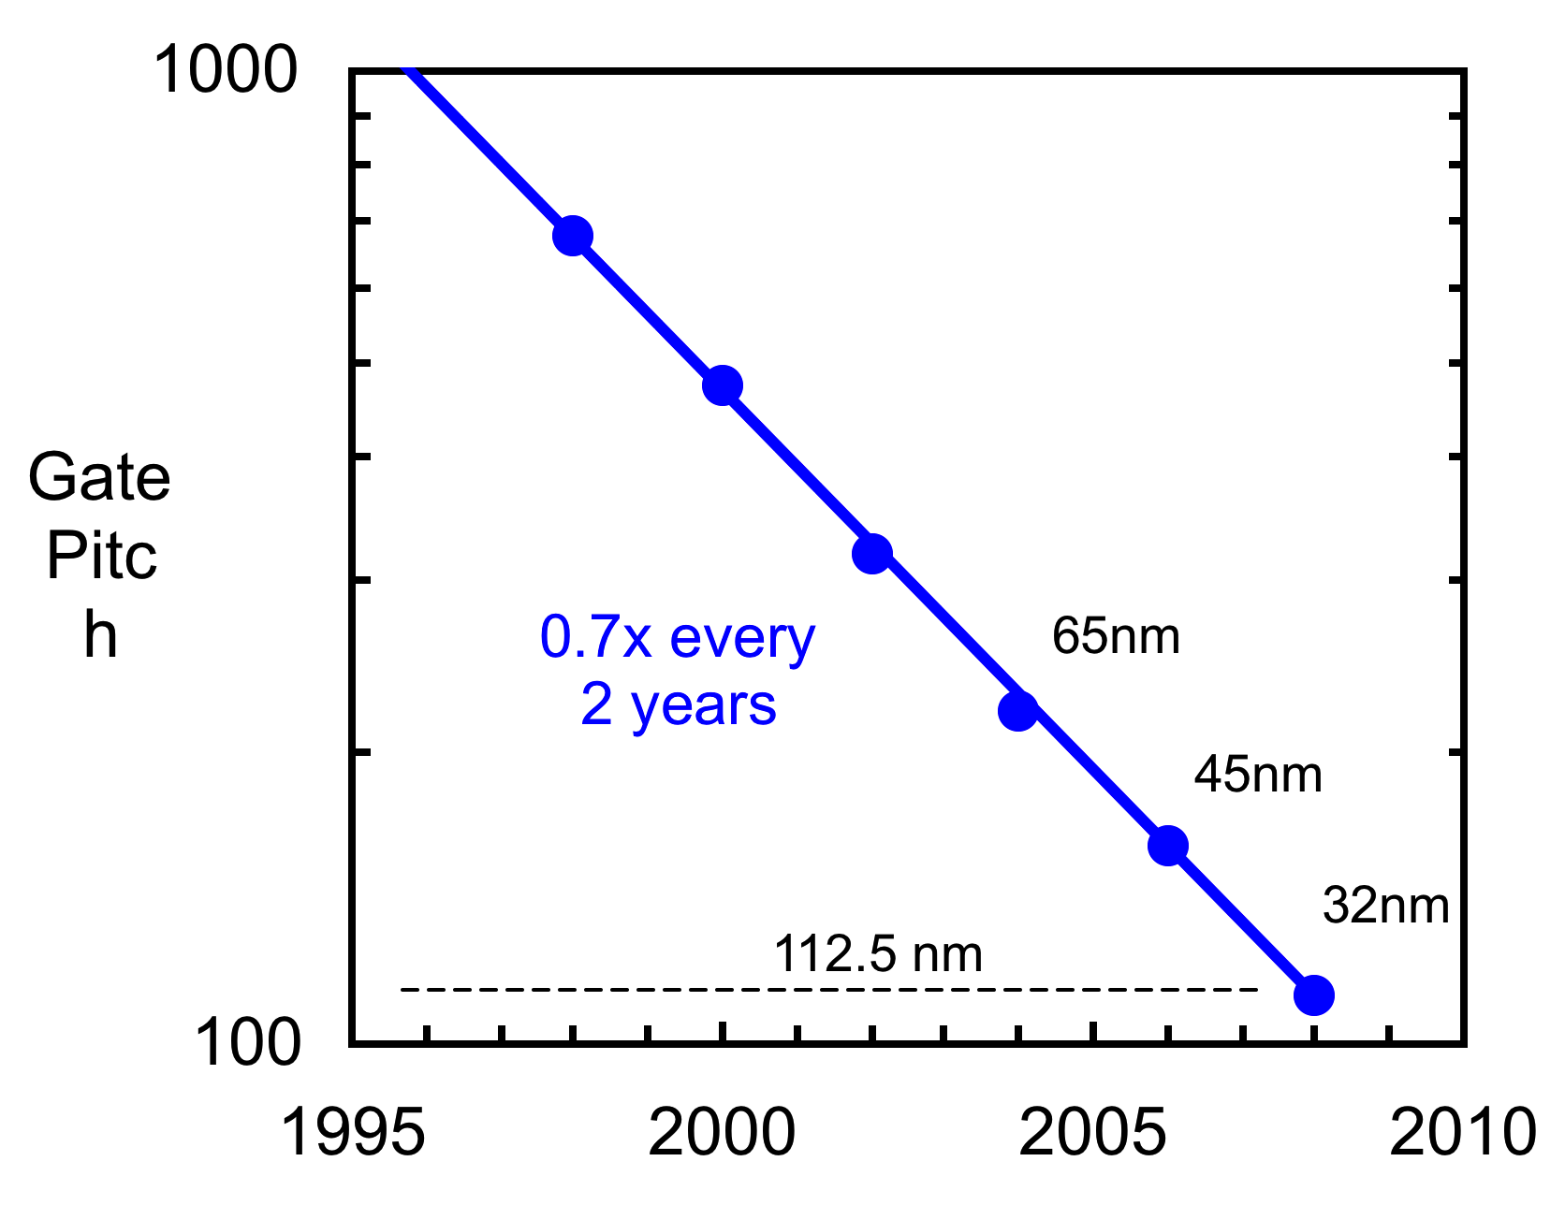
Transistor Density
Intel 32 nm transistors provide the tightest gate pitch of any reported 32 nm or 28 nm technology
Ghani, Intel

Slide 9
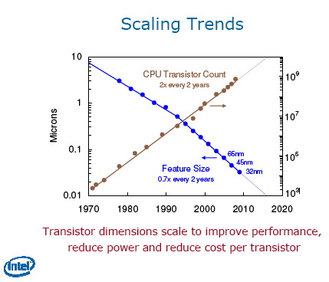
22nm

Slide 10
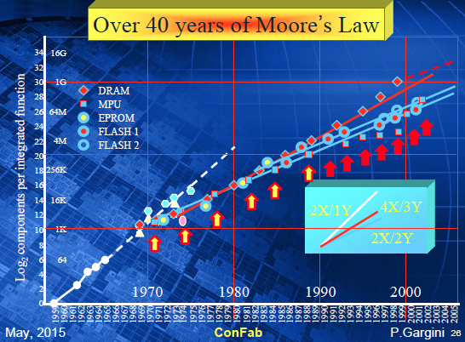

Slide 11
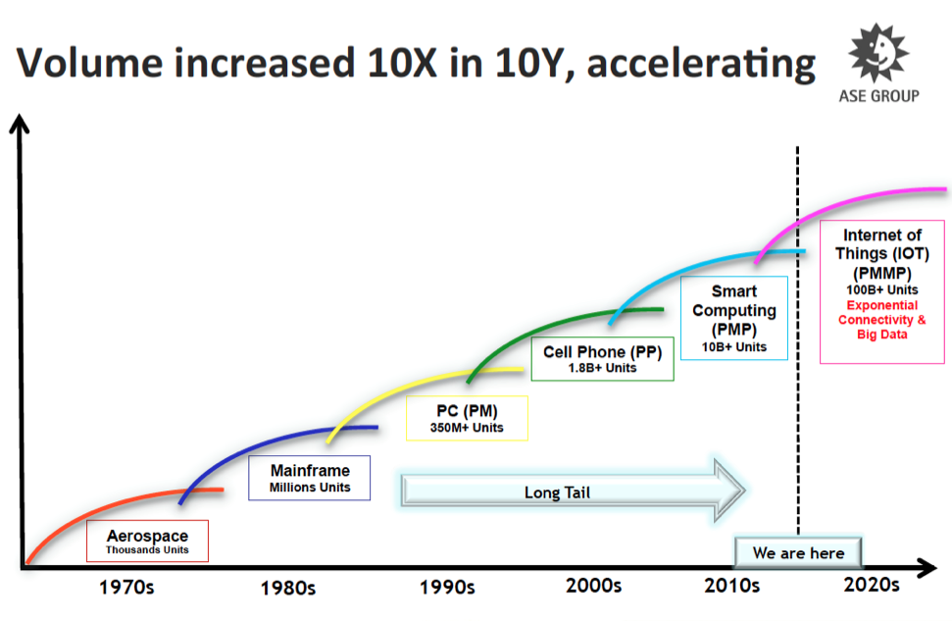

Slide 12
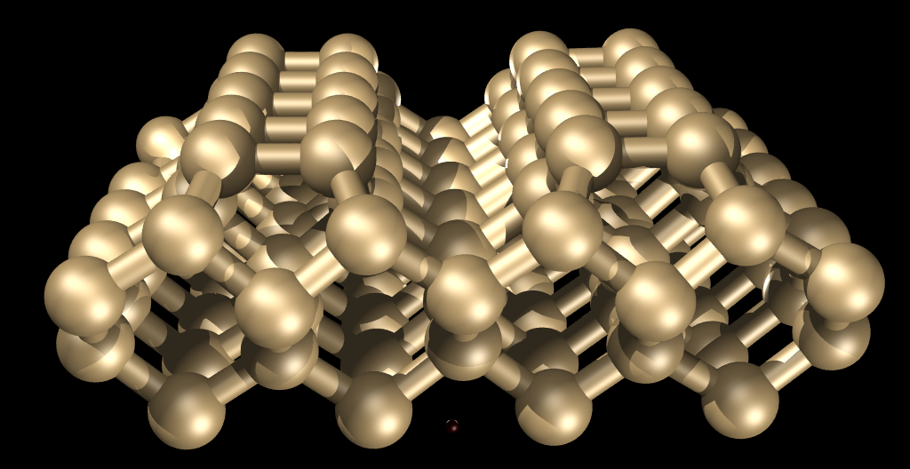
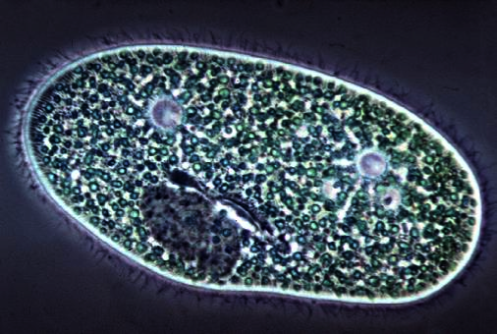
Device Scaling Over Time
~13% decrease in feature size each year (now: ~10%)
Era of Simple Scaling
~16% increase in complexity each year (now:6.3% for µP, 12% for DRAM)
Cell dimensions
0.25µm in 1997
Scaling + Innovation
(ITRS)
Invention
Atomic dimensions
• The era of “easy” scaling is over. We are now in a period where
technology and device innovations are required. Beyond 2020, new
currently unknown inventions will be required.

Slide 13
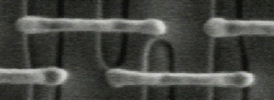


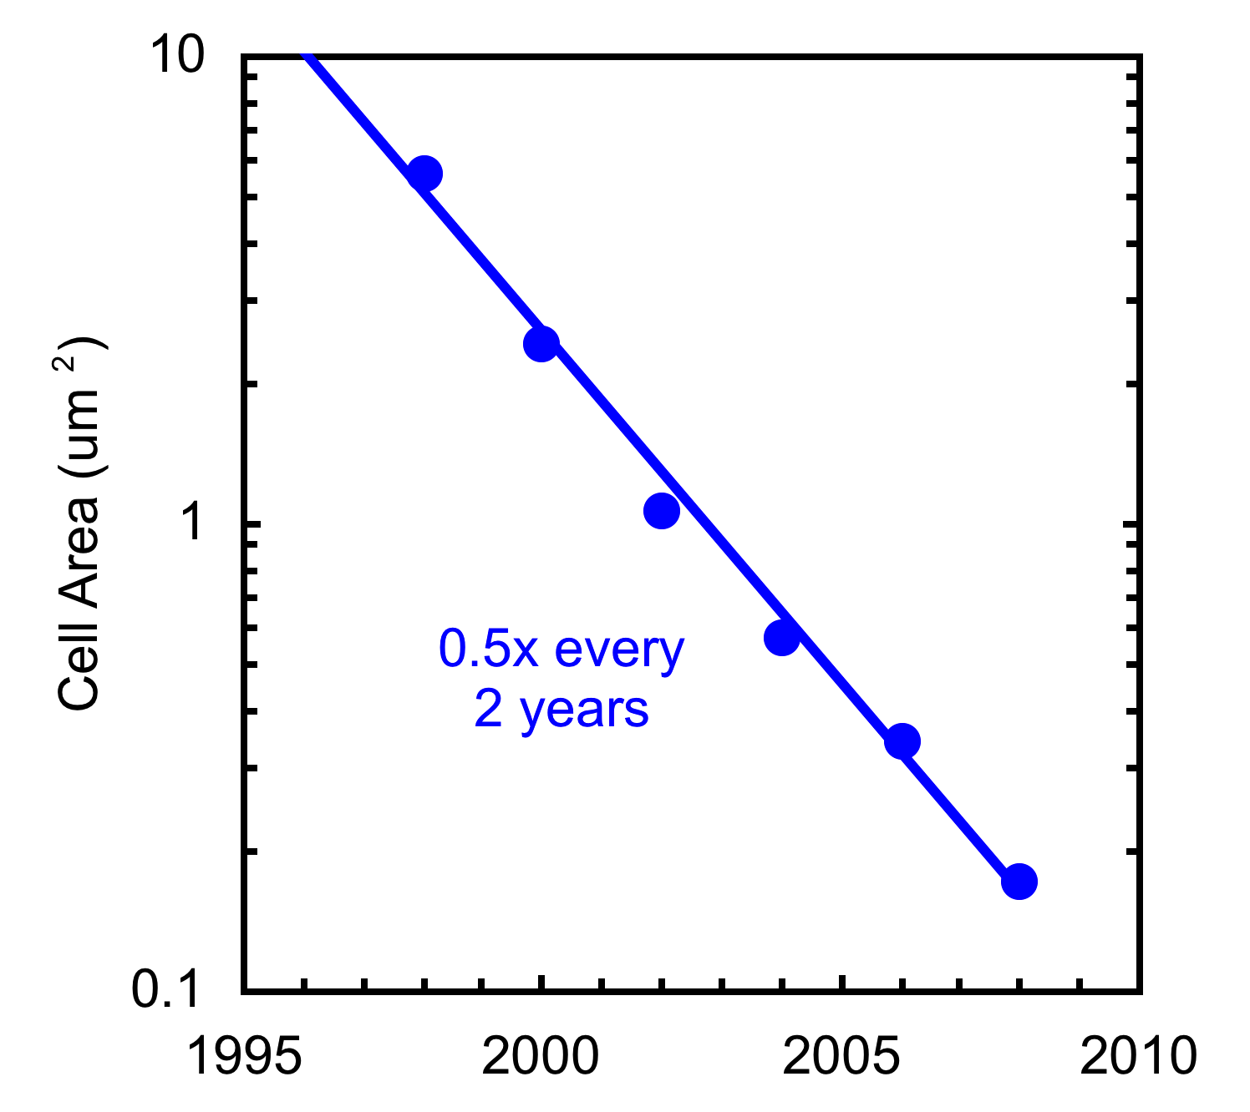
SRAM Cell Size Scaling
65 nm, 0.570 um²
45 nm, 0.346 um²
32 nm, 0.171 um²
Transistor density continues to double every 2 years
Ghani, Intel

Slide 14
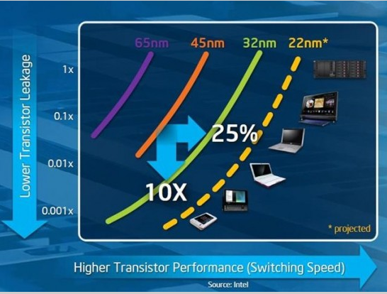

Slide 15
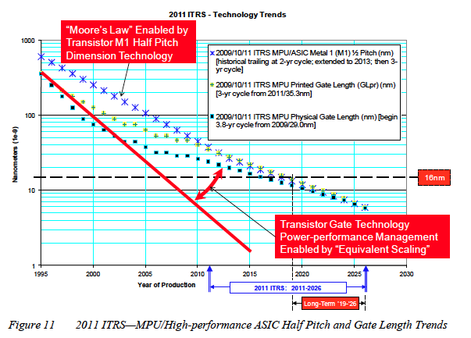
ITRS.net

Slide 16
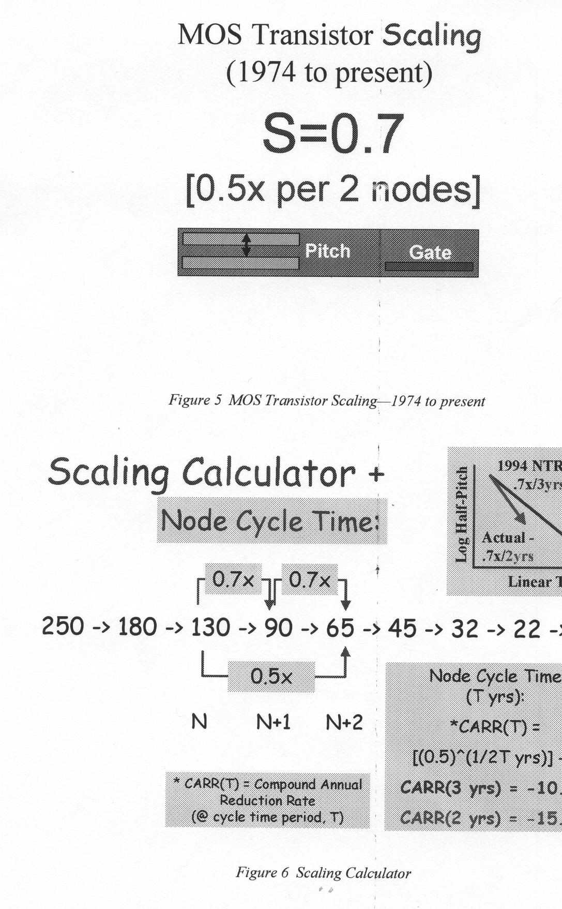
1999
2001
2004
2007
2010
2013
2016
1997
2 nodes
G. Marcyk, Intel

Slide 17
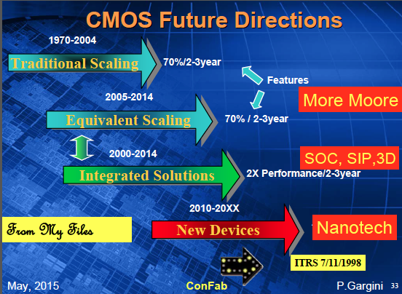

Slide 18
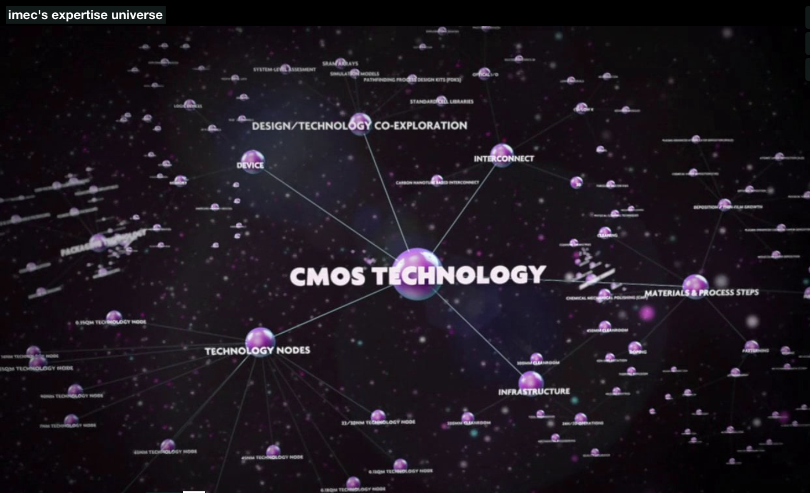
http://www2.imec.be/be_en/research.html

Slide 19
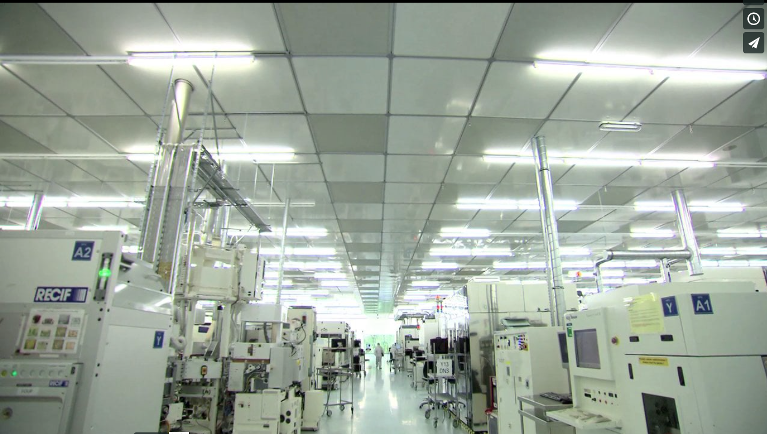
http://www2.imec.be/be_en/about-imec/infrastructure/cleanrooms.html

Slide 20
Evolution of the Fabrication Process: The Planar Design of Bipolar Transistors
Beginning of the Silicon Technology and the End of Ge devices
Oxidation possible for Si not good for Ge
Implementation of a masking oxide to protect junctions at the Si surface
Lithography to open window in SiO₂
SiO₂
Mask
Boron diffusion
Phosphorus diffusion through the oxide mask
Oxidation and outdiffusion
The planar process of Hoerni and Fairchild (1950s)

Slide 21
Beginning of Integrated Circuits in 1959
Kilby (TI) and Noyce (Fairchild Semiconductors)
Photolithography used for Pattern Formation
Sensitive to light
Durable in etching
• Basic lithography process
which is central to today’s
chip fabrication.

Slide 22
Alignment of Layers to Fabricate IC Elements
• Lithographic process allows integration of multiple devices side by side on a wafer.
Bipolar Transistor and resistors made in the base region
Accuracy of placement ~1/4 to 1/3 of the linewidth being printed
BJT
B
Vcc
0V
C
E
Resistor
Base
Resistor
R=L/W•R_{s}
Contact to collector
Emitter
Collector

Slide 23
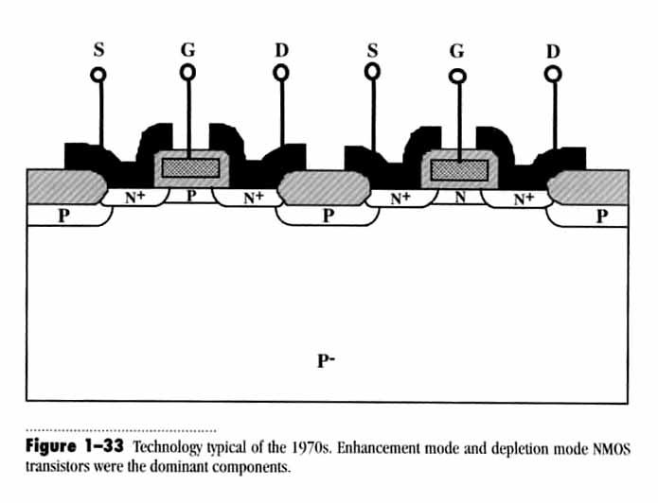
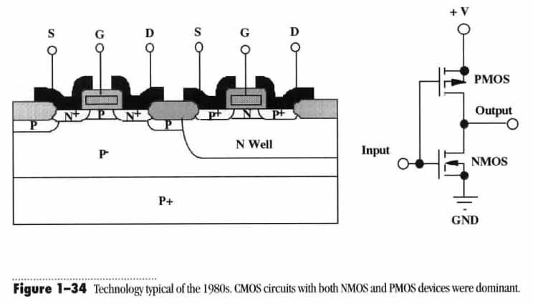
NMOS and CMOS Technologies
Enhancement NMOS Depletion NMOS
1970s
NMOS
1980s and beyond
PMOS
Smaller power consumption

Slide 24
Schematic Cross-Section of Modern CMOS Integrated Circuit with Two Metal Levels
IC is located at the surface of a Si wafer (~500µm thick)
Interconnect
M2
Via
OXIDE
M1
Silicide
TiN
Oxide Isolation
PMOS
NMOS

Slide 25
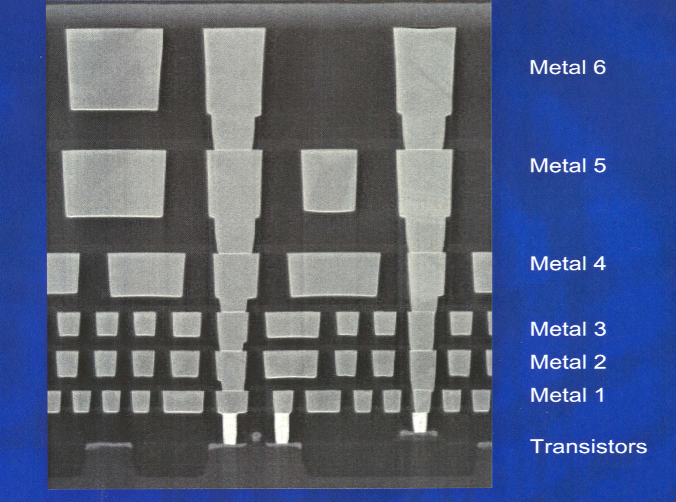
• Actual cross-section of a modern
microprocessor chip. Note the
multiple levels of metal and
planarization. (Intel website).
Computer Simulation Tools (TCAD)
•Most of the basic technologies in silicon chip manufacturing can now be simulated.
Simulation is now used for:
• Designing new processes and devices.
• Exploring the limits of semiconductor devices and technology (R&D).
• “Centering” manufacturing processes.
• Solving manufacturing problems (what-if?)

Slide 26
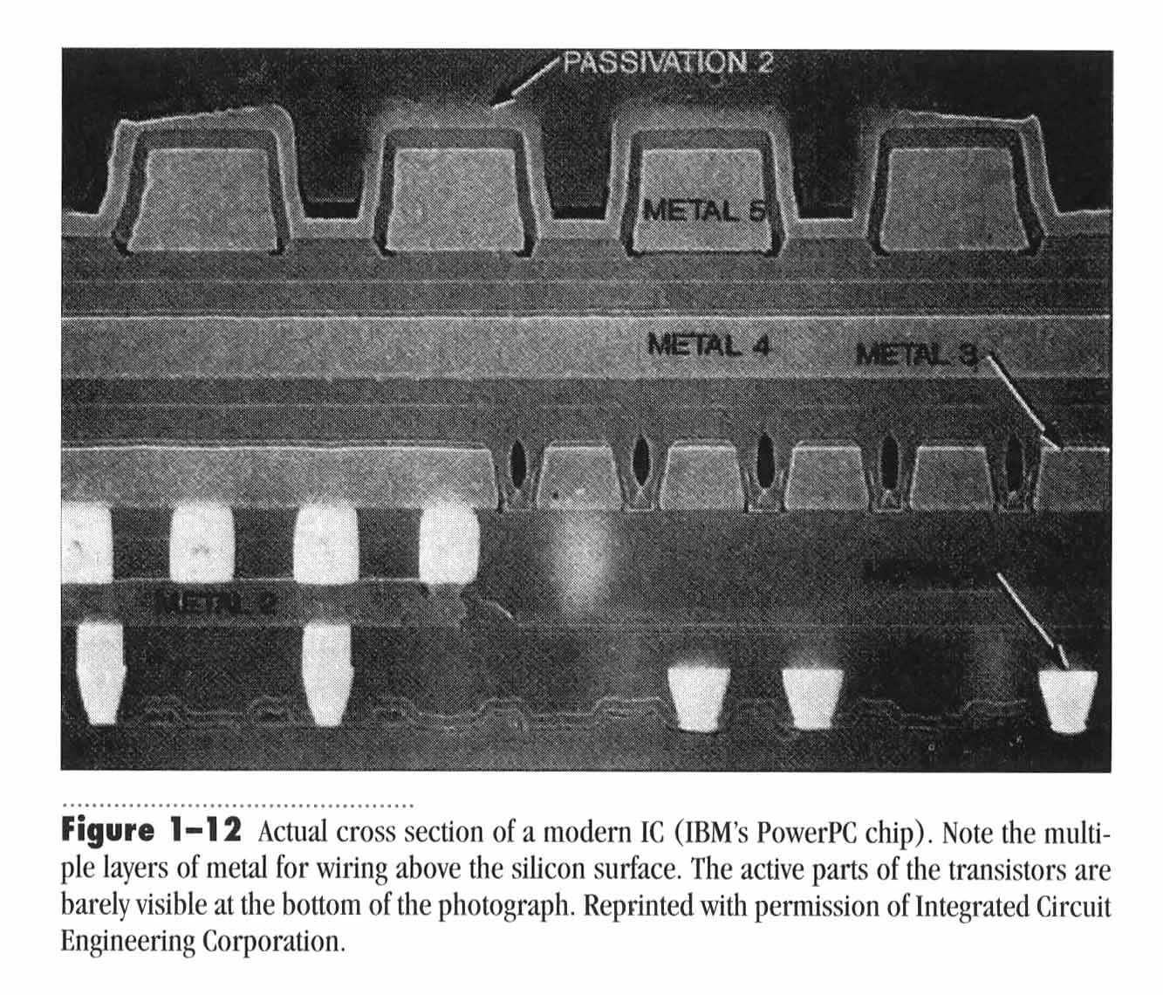
Modern IC with a Five Level Metallization Scheme.
Planarization

Slide 27
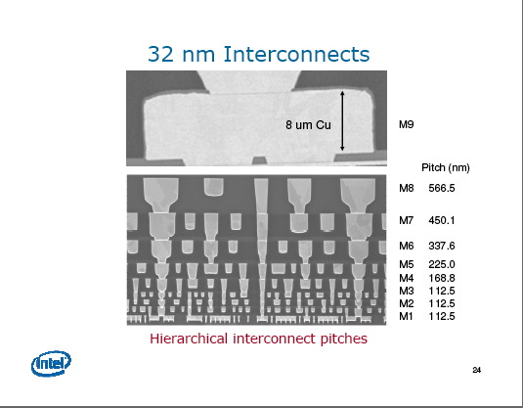

Slide 28
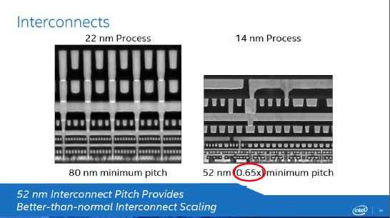

Slide 29
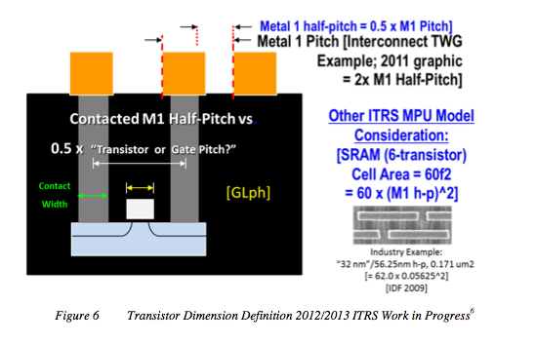
“Nodes”
This graphic clarifies the ORTC Table 1 relationship to gate length. It illustrates consistency with Interconnect TWG transistor M1 contacted half-pitch (also known as “transistor pitch” or “gate pitch”) versus printed gate length (GLpr) and measurable physical gate length (GLph). This dimension is sometimes compared to critical dimension (CD) for manufacturing process control.
The ITRS does not utilize any single-product “node” designation reference. Flash Poly and DRAM M1 half-pitch are still lithography drivers; however, other product technology trends may be drivers on individual TWG tables.
ITRS.net

Slide 30
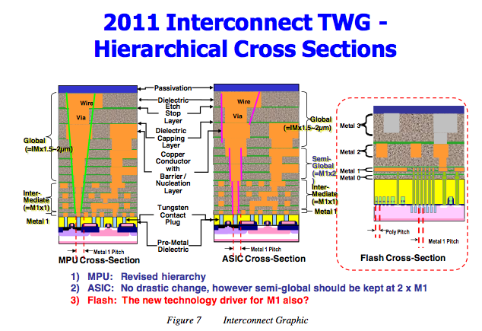
ITRS.net

Slide 31
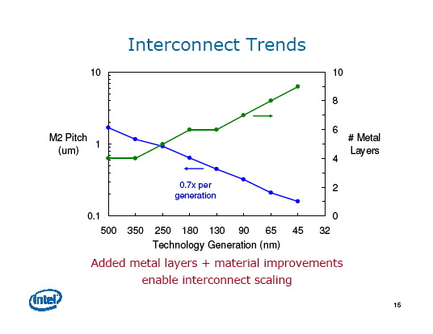

Slide 32
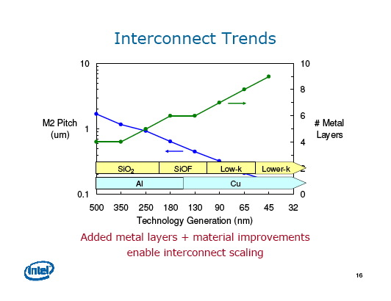

Slide 33
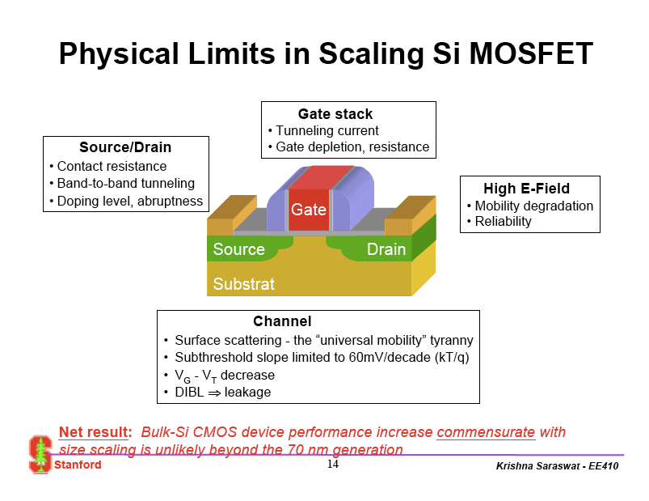

Slide 34
Intel Logic Technology Roadmap
45 nm 32 nm 22 nm
Process Name: P1266 P1268 P1270
Products: CPU CPU CPU
1st Production: 2007 2009 2011
Intel 32nm: 2nd generation high-k + metal gate
transistors
Ghani, Intel

Slide 35
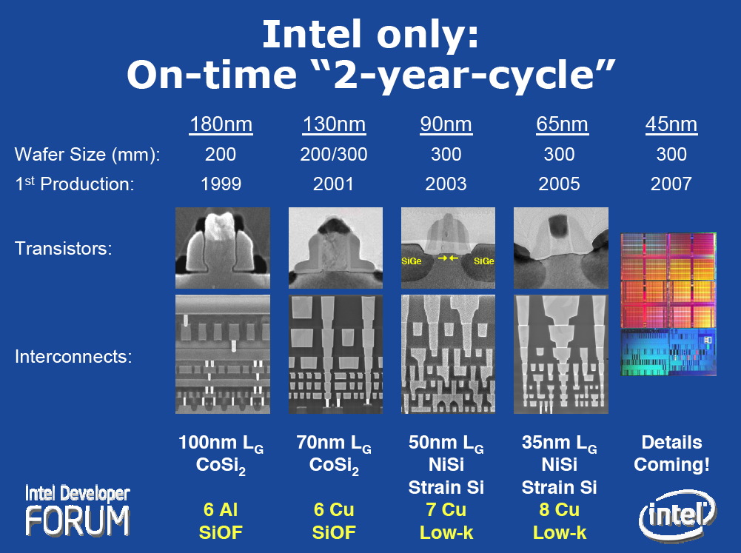

Slide 36
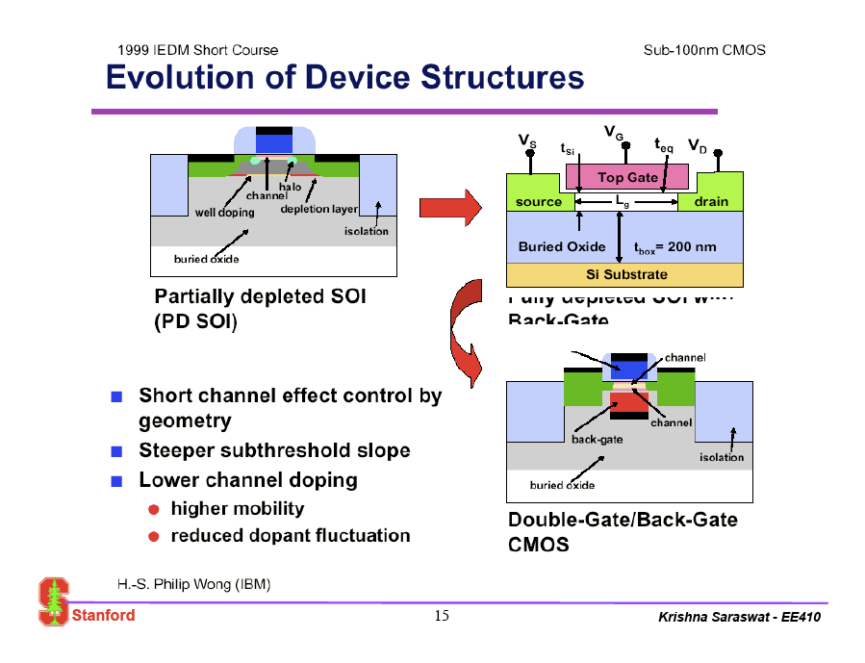

Slide 37
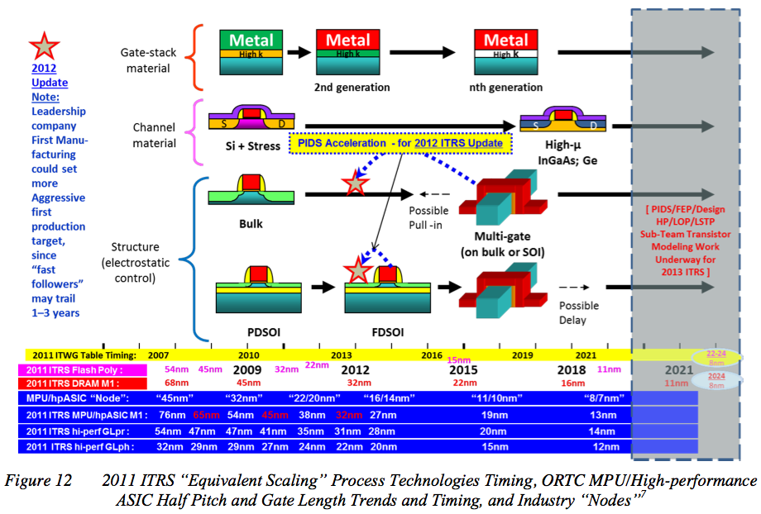
ITRS.net

Slide 38
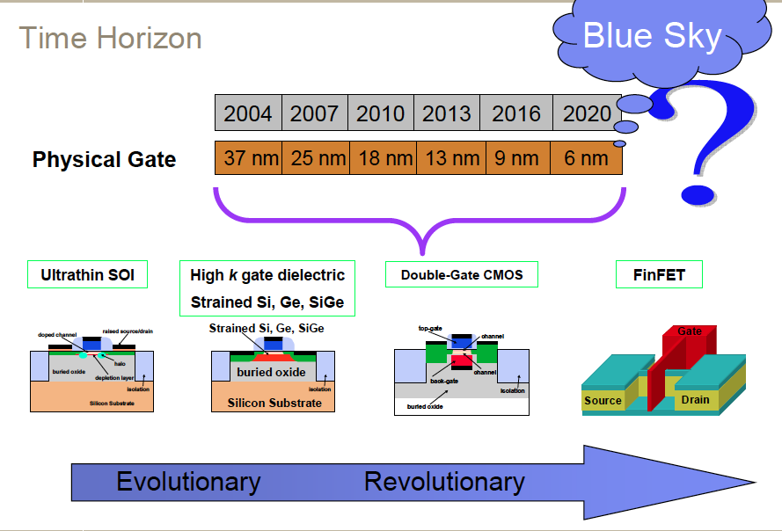

Slide 39
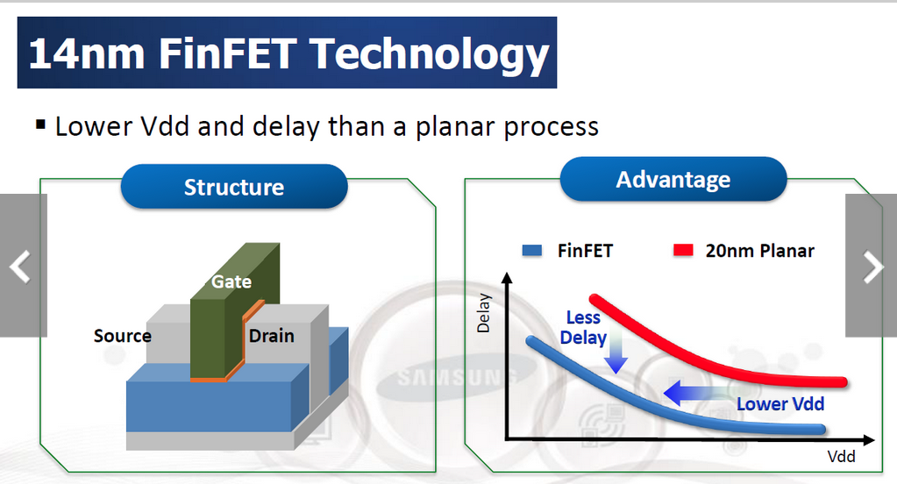

Slide 40
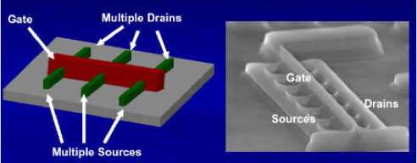

Slide 41
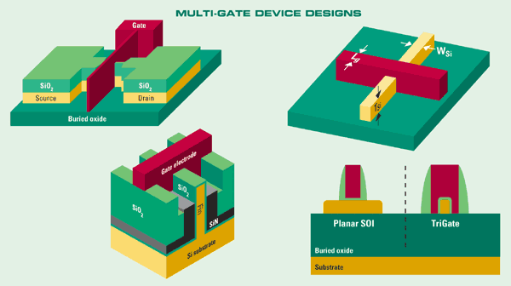
The traditional finFET (upper left), a trigate on SOI (upper right), trigate on bulk silicon (lower left) and a pseudo-trigate on SOI (lower right). (Source: Texas Instruments)

Slide 42
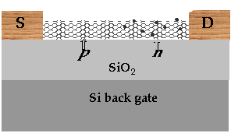
Challenges For The Future
• Having a “roadmap” suggests that the future is well defined and there are
few challenges to making it happen.
• The truth is that there are enormous technical hurdles to actually achieving
the forecasts of the roadmap. Scaling is no longer enough.
• 3 stages for future development:
“Technology Performance Boosters”
Invention
Gate
• Spin-based devices
• Molecular devices
• Rapid single flux quantum
• Quantum cellular automata
• Resonant tunneling devices
• Single electron devices
Source
Drain
???
Materials/process innovations
NOW
Beyond Si CMOS
IN 15 YEARS??
Device innovations
IN 5-15 YEARS
Plummer et al.

Slide 43
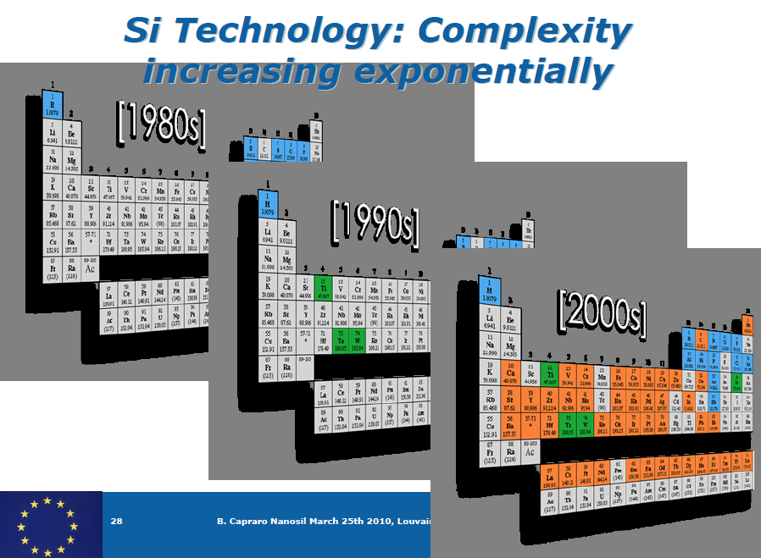

Slide 44
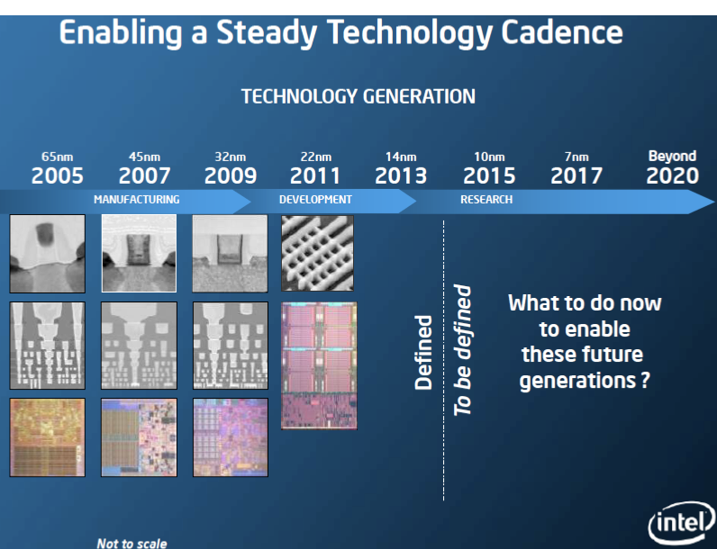

Slide 45
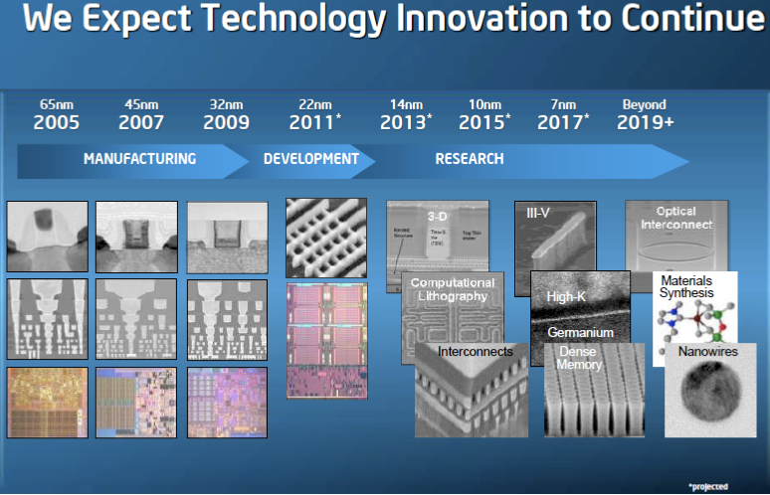

Slide 46
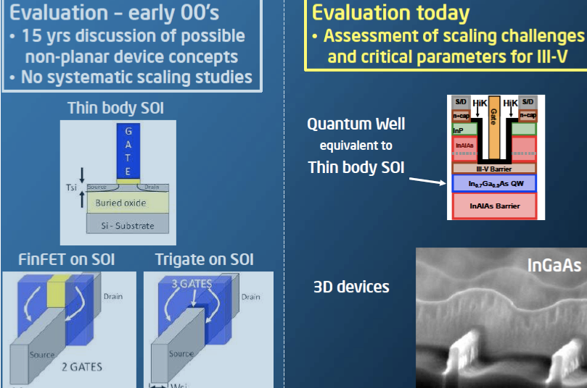

Slide 47
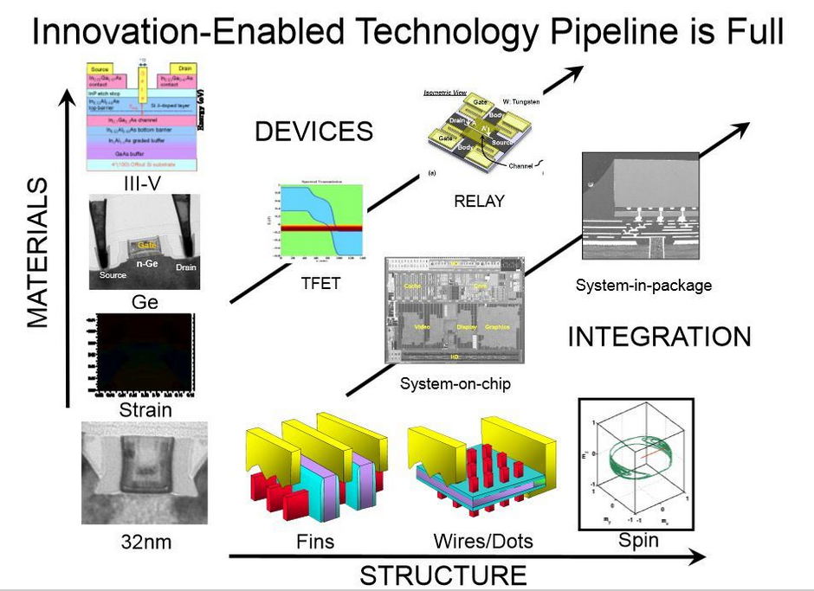

Slide 48
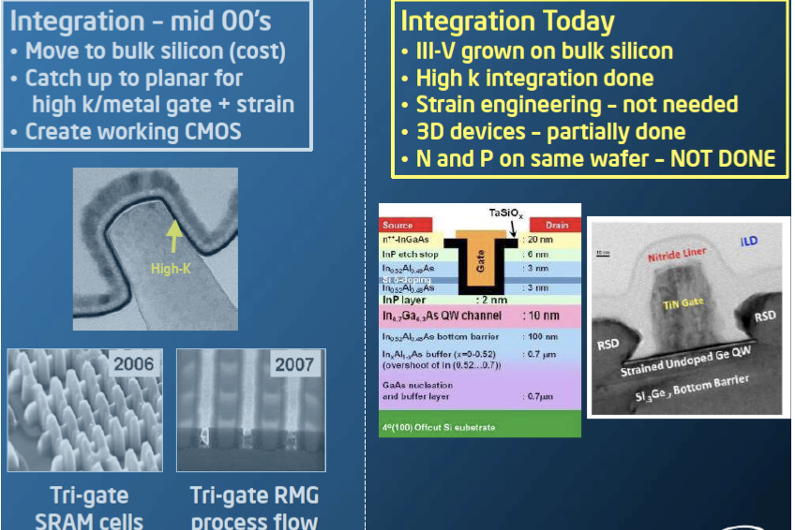

Slide 49
Possible Future Transistor Options
Advanced Channel Materials
- III-V and Ge channel materials
Multi-Gate Fin Transistors
- Non planar architecture
Tunnel Transistors
- New transport mechanism
Each transistor structure has many significant
challenges which will have to be successfully addressed
if it is to become a serious contender to silicon MOSFET
Ghani, Intel

Slide 50
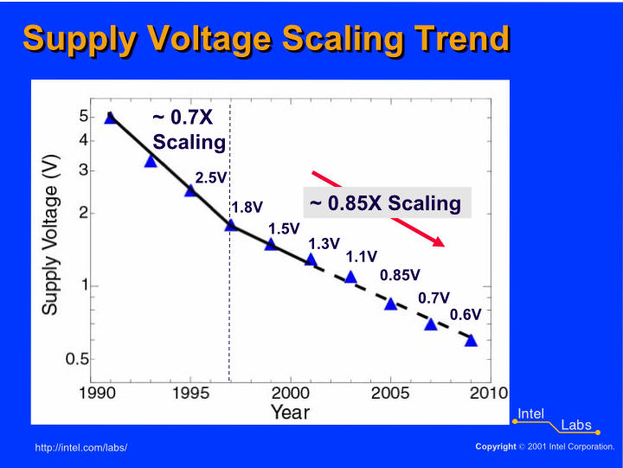

Slide 51
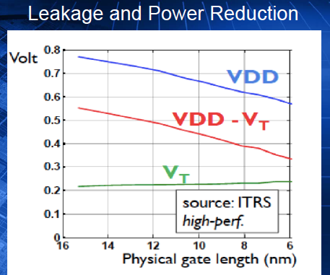

Slide 52
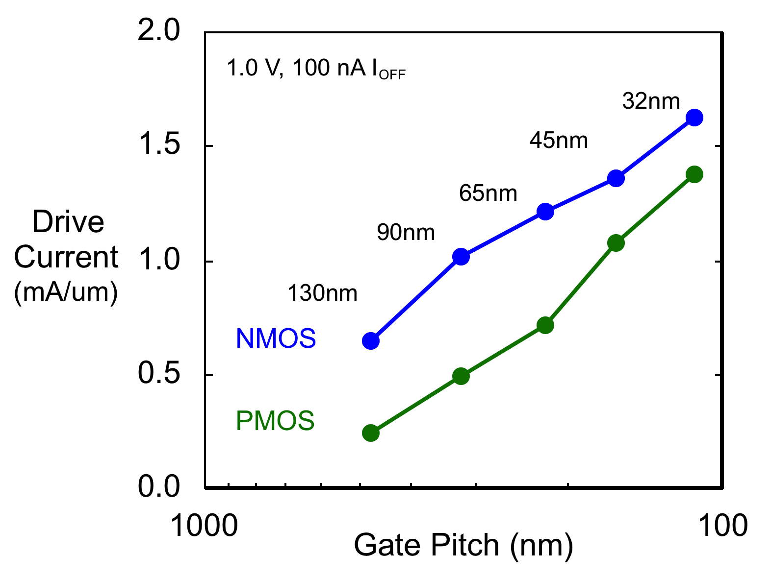
Transistor Performance
Intel 32 nm transistors provide the highest drive currents of any reported 32 nm or 28 nm technology
Ghani, Intel

Slide 53
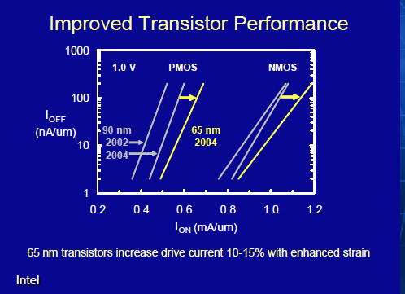

Slide 54
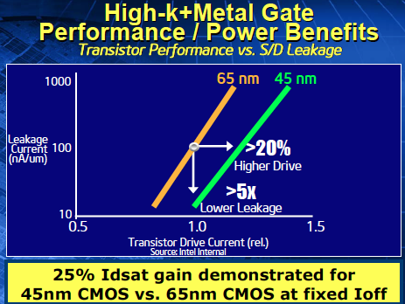
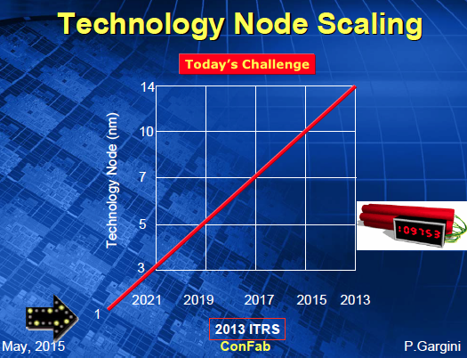

?

Slide 55
CPU Transistor Count & Power Trend
1.E+10
1.E+10
1.E+09
Itanium® 2 CPU
1.E+09
1.E+08
Pentium® 4 CPU
Penryn
QC
1.E+08
1.E+07
Pentium® II CPU
1.E+07
1.E+06
486
TM
1.E+06
1.E+05
286
2x increase every
2 years
1.E+05
1.E+04
8080
1.E+04
1.E+03
4004
1.E+03
1970
1980
1990
2000
2010
Power Dissipation Limited to ~100W
BUT increased transistor count needed
in Multi-Core CPU Era !!!
Ghani, Intel

Slide 56


Slide 57


Slide 58


Slide 59

Trends in Scaling
Si Microeletronics and MEMS

Slide 60

Trends in Increasing Integration Scale of Circuits
Past, Present, and Future ICs
ITRS at http://public.itrs.net
• Assumes that CMOS technology dominates over the entire roadmap.
• 2 year cycle moving to 3 years (scaling + innovation now required).
• 1990 IBM demo of Å scale “lithography”.
• Technology appears to be capable of making structures much smaller than
currently known device limits.

Slide 61
Fundamental Trends
High Volume Manufacturing | 2004 | 2006 | 2008 | 2010 | 2012 | 2014 | 2016 | 2018
Technology Node (nm) | 90 | 65 | 45 | 32 | 22 | 16 | 11 | 8
Integration Capacity (BT) | 2 | 4 | 8 | 16 | 32 | 64 | 128 | 256
Delay = CV/I scaling | 0.7 | ~0.7 | >0.7 | Delay scaling will slow down
Energy/Logic Op scaling | >0.35 | >0.5 | >0.5 | Energy scaling will slow down
Bulk Planar CMOS | High Probability Low Probability
Alternate, 3G etc | Low Probability High Probability
Variability | Medium High Very High
ILD (K) | ~3 | <3 | Reduce slowly towards 2-2.5
RC Delay | 1 | 1 | 1 | 1 | 1 | 1 | 1 | 1
Metal Layers | 6-7 | 7-8 | 8-9 | 0.5 to 1 layer per generation
Source: Shekhar Borkar, Intel Corp.

Slide 62


Slide 63


Slide 64

Scaling - Yields

Slide 65


Slide 66


Slide 67


Slide 68


Slide 69


Slide 70


Slide 71


Slide 72


Slide 73


Slide 74


Slide 75
Key Messages / Summary
Intel’s Response to end of “traditional-scaling”:
  Uniaxial Strain (90nm and beyond): 32nm is 4th generation of uniaxial strain at Intel
  HiK + Metal Gate (45nm and beyond at Intel)
Future Novel Transistors:
  New Channel Materials:
  Integrate Ge & III-V on top of Silicon. Many device and material challenges remain
  Multi-Gate Fin Transistors:
  Scaling benefits BUT need to demonstrate effective strain implementation,
  matched parasitic resistance to planar and overcome patterning challenges
  BTBT (Tunnel) Transistors:
  Ultimate transistors may need tunnel injection at ultra-low Vcc. Would need
  new materials with more efficient tunneling and atomic scale fabrication control
These innovations have enabled Intel to maintain historical performance gains on recent nodes
Many exciting materials, physics and integration
challenges left to continue CMOS scaling
Ghani, Intel

Slide 76


Slide 77


Slide 78

Don’t Forget About MEMS

